Slide 1
Week 5 Integrals: anti-derivative, area under curve, multivariate functions

Slide 2
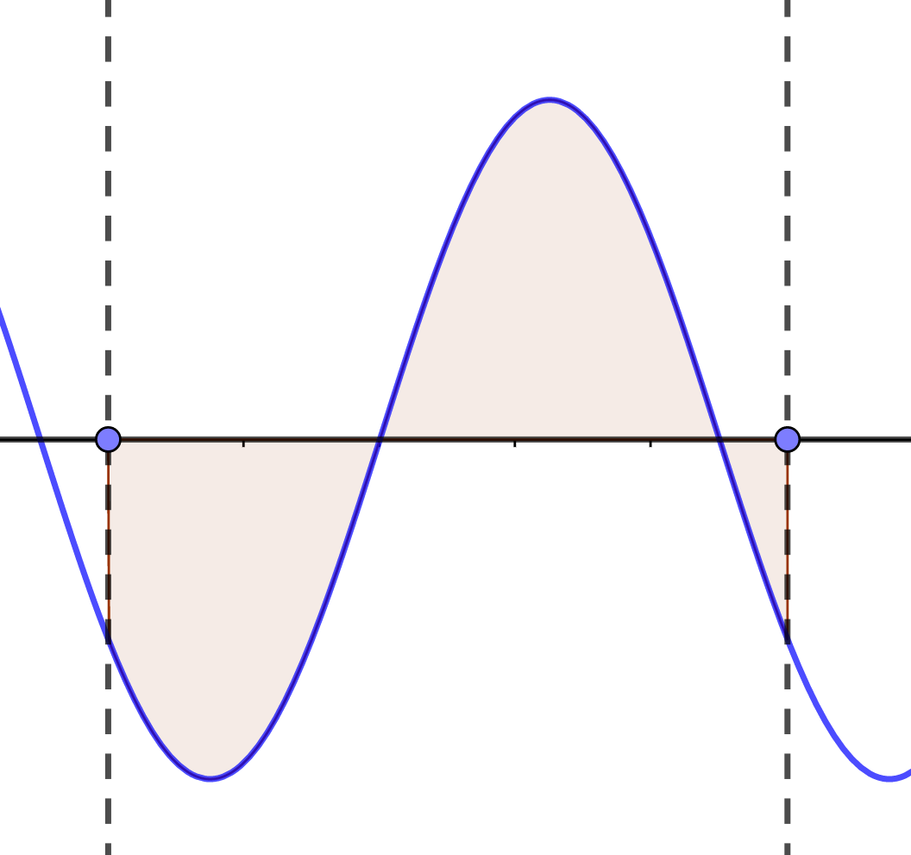
Introduction
We now know how to compute derivatives
One should consider the inverse operation to differentiation – integration
Integrals can be seen as continuous summation

Slide 3

Antiderivative: definition
Let us start with a following puzzle: imagine, we have
$$f^{′}\left(x\right)=3x^{2}+x$$
Let us find $f\left(x\right).$

Slide 4
Antiderivative: definition
Let us start with a following puzzle: imagine, we have
$$f^{′}\left(x\right)=3x^{2}+x$$
Let us find $f\left(x\right).$
So, we have found $f\left(x\right)=x^{3}+x^{2}/2$. That’s all?

Slide 5

Antiderivative: definition
Let us start with a following puzzle: imagine, we have
$$f^{′}\left(x\right)=3x^{2}+x$$
Let us find $f\left(x\right).$
So, we have found $f\left(x\right)=x^{3}+x^{2}/2$. That’s all?
Obviously, we can add any possible constant to the answer
$$f\left(x\right)=x^{3}+x^{2}/2+C$$

Slide 6

Antiderivative: definition
Let us start with a following puzzle: imagine, we have
$$f^{′}\left(x\right)=3x^{2}+x$$
Let us find $f\left(x\right).$
So, we have found $f\left(x\right)=x^{3}+x^{2}/2$. That’s all?
Obviously, we can add any possible constant to the answer
$$f\left(x\right)=x^{3}+x^{2}/2+C$$
Assume the function $f(x)$ is given. Function $F(x)$ is called an antiderivative of $f(x)$, if $F^{′}\left(x\right)=f(x)$.

Slide 7
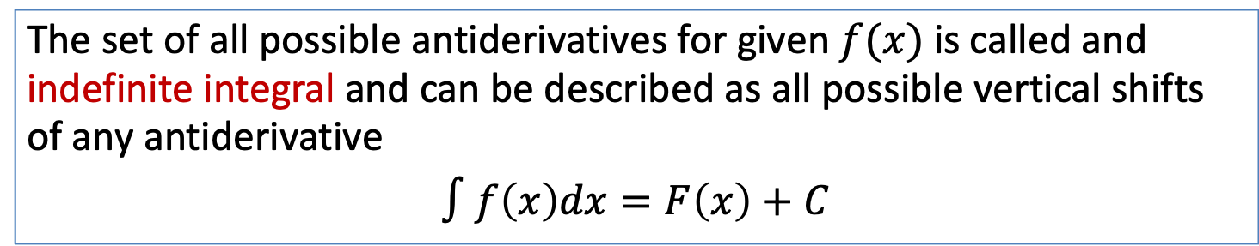
Antiderivative: definition
Let us start with a following puzzle: imagine, we have
$$f^{′}\left(x\right)=3x^{2}+x$$
Let us find $f\left(x\right).$
So, we have found $f\left(x\right)=x^{3}+x^{2}/2$. That’s all?
Obviously, we can add any possible constant to the answer
$$f\left(x\right)=x^{3}+x^{2}/2+C$$
Assume the function $f(x)$ is given. Function $F(x)$ is called an antiderivative of $f(x)$, if $F^{′}\left(x\right)=f(x)$.
The set of all possible antiderivatives for given $f(x)$ is called and indefinite integral and can be described as all possible vertical shifts of any antiderivative
$$∫f\left(x\right)dx=F\left(x\right)+C$$

Slide 8
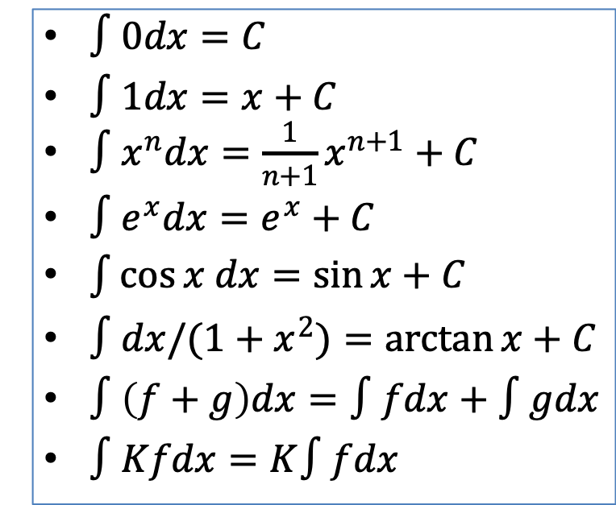
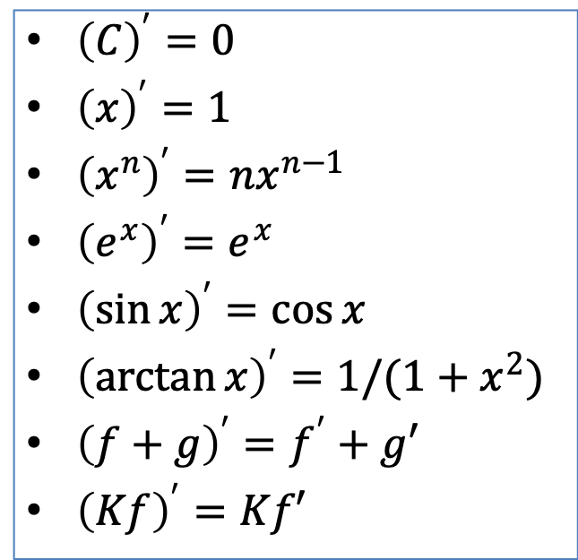
Antiderivative: table of integrals
${\left(C\right)}^{′}=0$
${\left(x\right)}^{′}=1$
${\left(x^{n}\right)}^{′}=nx^{n−1}$
${\left(e^{x}\right)}^{′}=e^{x}$
${\left(\sin{x}\right)}^{′}=\cos{x}$
${\left(\arctan{x}\right)}^{′}=1/(1+x^{2})$
${\left(f+g\right)}^{′}=f^{′}+g′$
${\left(Kf\right)}^{′}=Kf′$
$∫0dx=C$
$∫1dx=x+C$
$∫x^{n}dx=\frac{1}{n+1}x^{n+1}+C$
$∫e^{x}dx=e^{x}+C$
$\int{\cos{x dx=\sin{x}+C}}$
$∫dx/(1+x^{2})=\arctan{x+C}$
$∫\left(f+g\right)dx=∫fdx+∫gdx$
$∫Kfdx=K∫fdx$

Slide 9
Antiderivative: table of integrals
${\left(C\right)}^{′}=0$
${\left(x\right)}^{′}=1$
${\left(x^{n}\right)}^{′}=nx^{n−1}$
${\left(e^{x}\right)}^{′}=e^{x}$
${\left(\sin{x}\right)}^{′}=\cos{x}$
${\left(\arctan{x}\right)}^{′}=1/(1+x^{2})$
${\left(f+g\right)}^{′}=f^{′}+g′$
${\left(Kf\right)}^{′}=Kf′$
$∫0dx=C$
$∫1dx=x+C$
$∫x^{n}dx=\frac{1}{n+1}x^{n+1}+C$
$∫e^{x}dx=e^{x}+C$
$\int{\cos{x dx=\sin{x}+C}}$
$∫dx/(1+x^{2})=\arctan{x+C}$
$∫\left(f+g\right)dx=∫fdx+∫gdx$
$∫Kfdx=K∫fdx$
It’s the same table vice versa!

Slide 10
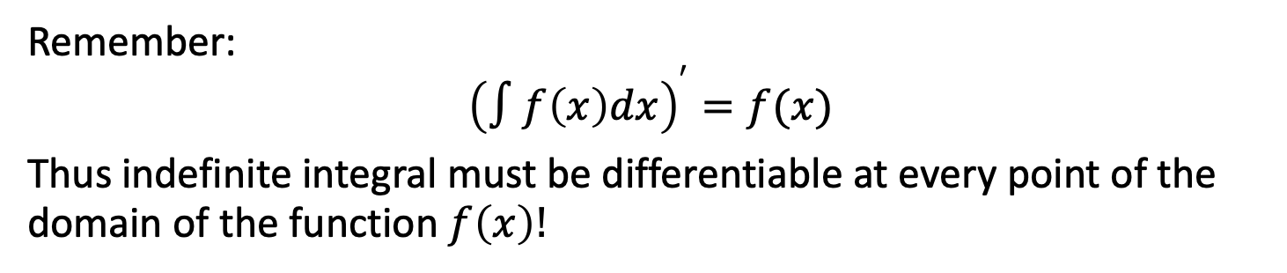
Antiderivative: definition
Remember:
$${\left(∫f\left(x\right)dx\right)}^{′}=f(x)$$
Thus indefinite integral must be differentiable at every point of the domain of the function $f\left(x\right)!$

Slide 11
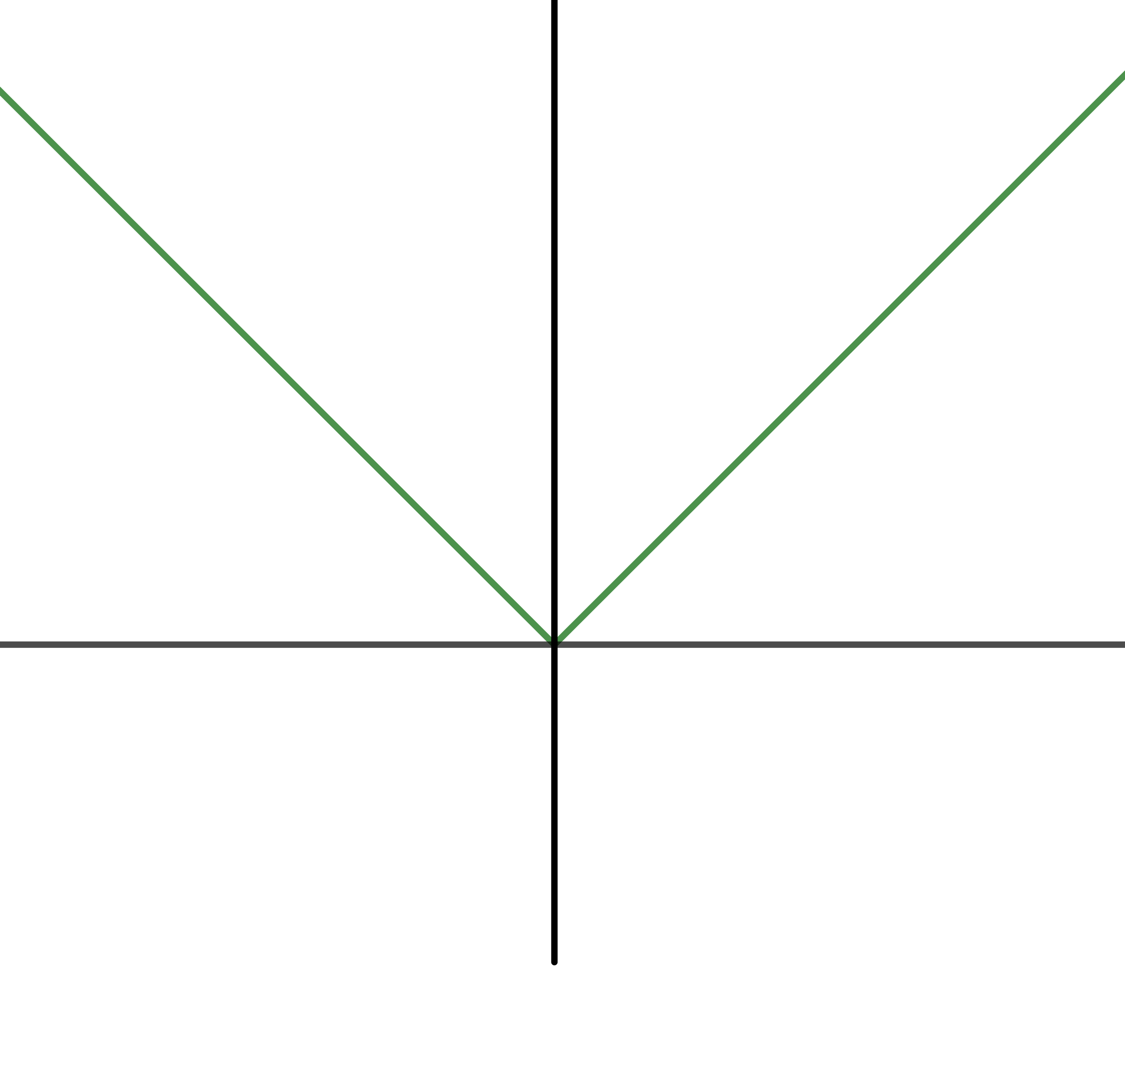
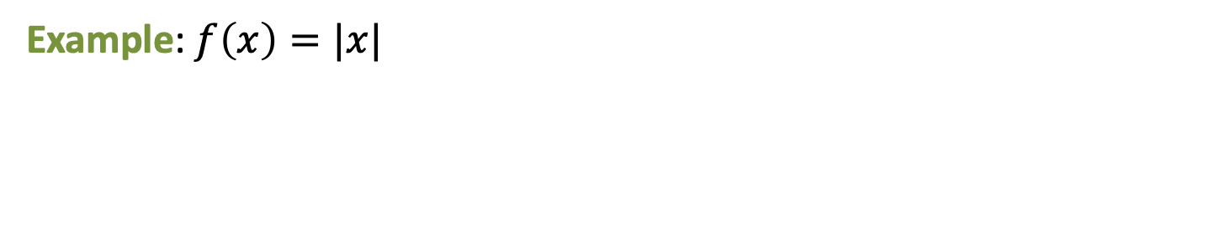
Antiderivative: definition
Remember:
$${\left(∫f\left(x\right)dx\right)}^{′}=f(x)$$
Thus indefinite integral must be differentiable at every point of the domain of the function $f\left(x\right)!$
Example: $f\left(x\right)=|x|$

Slide 12
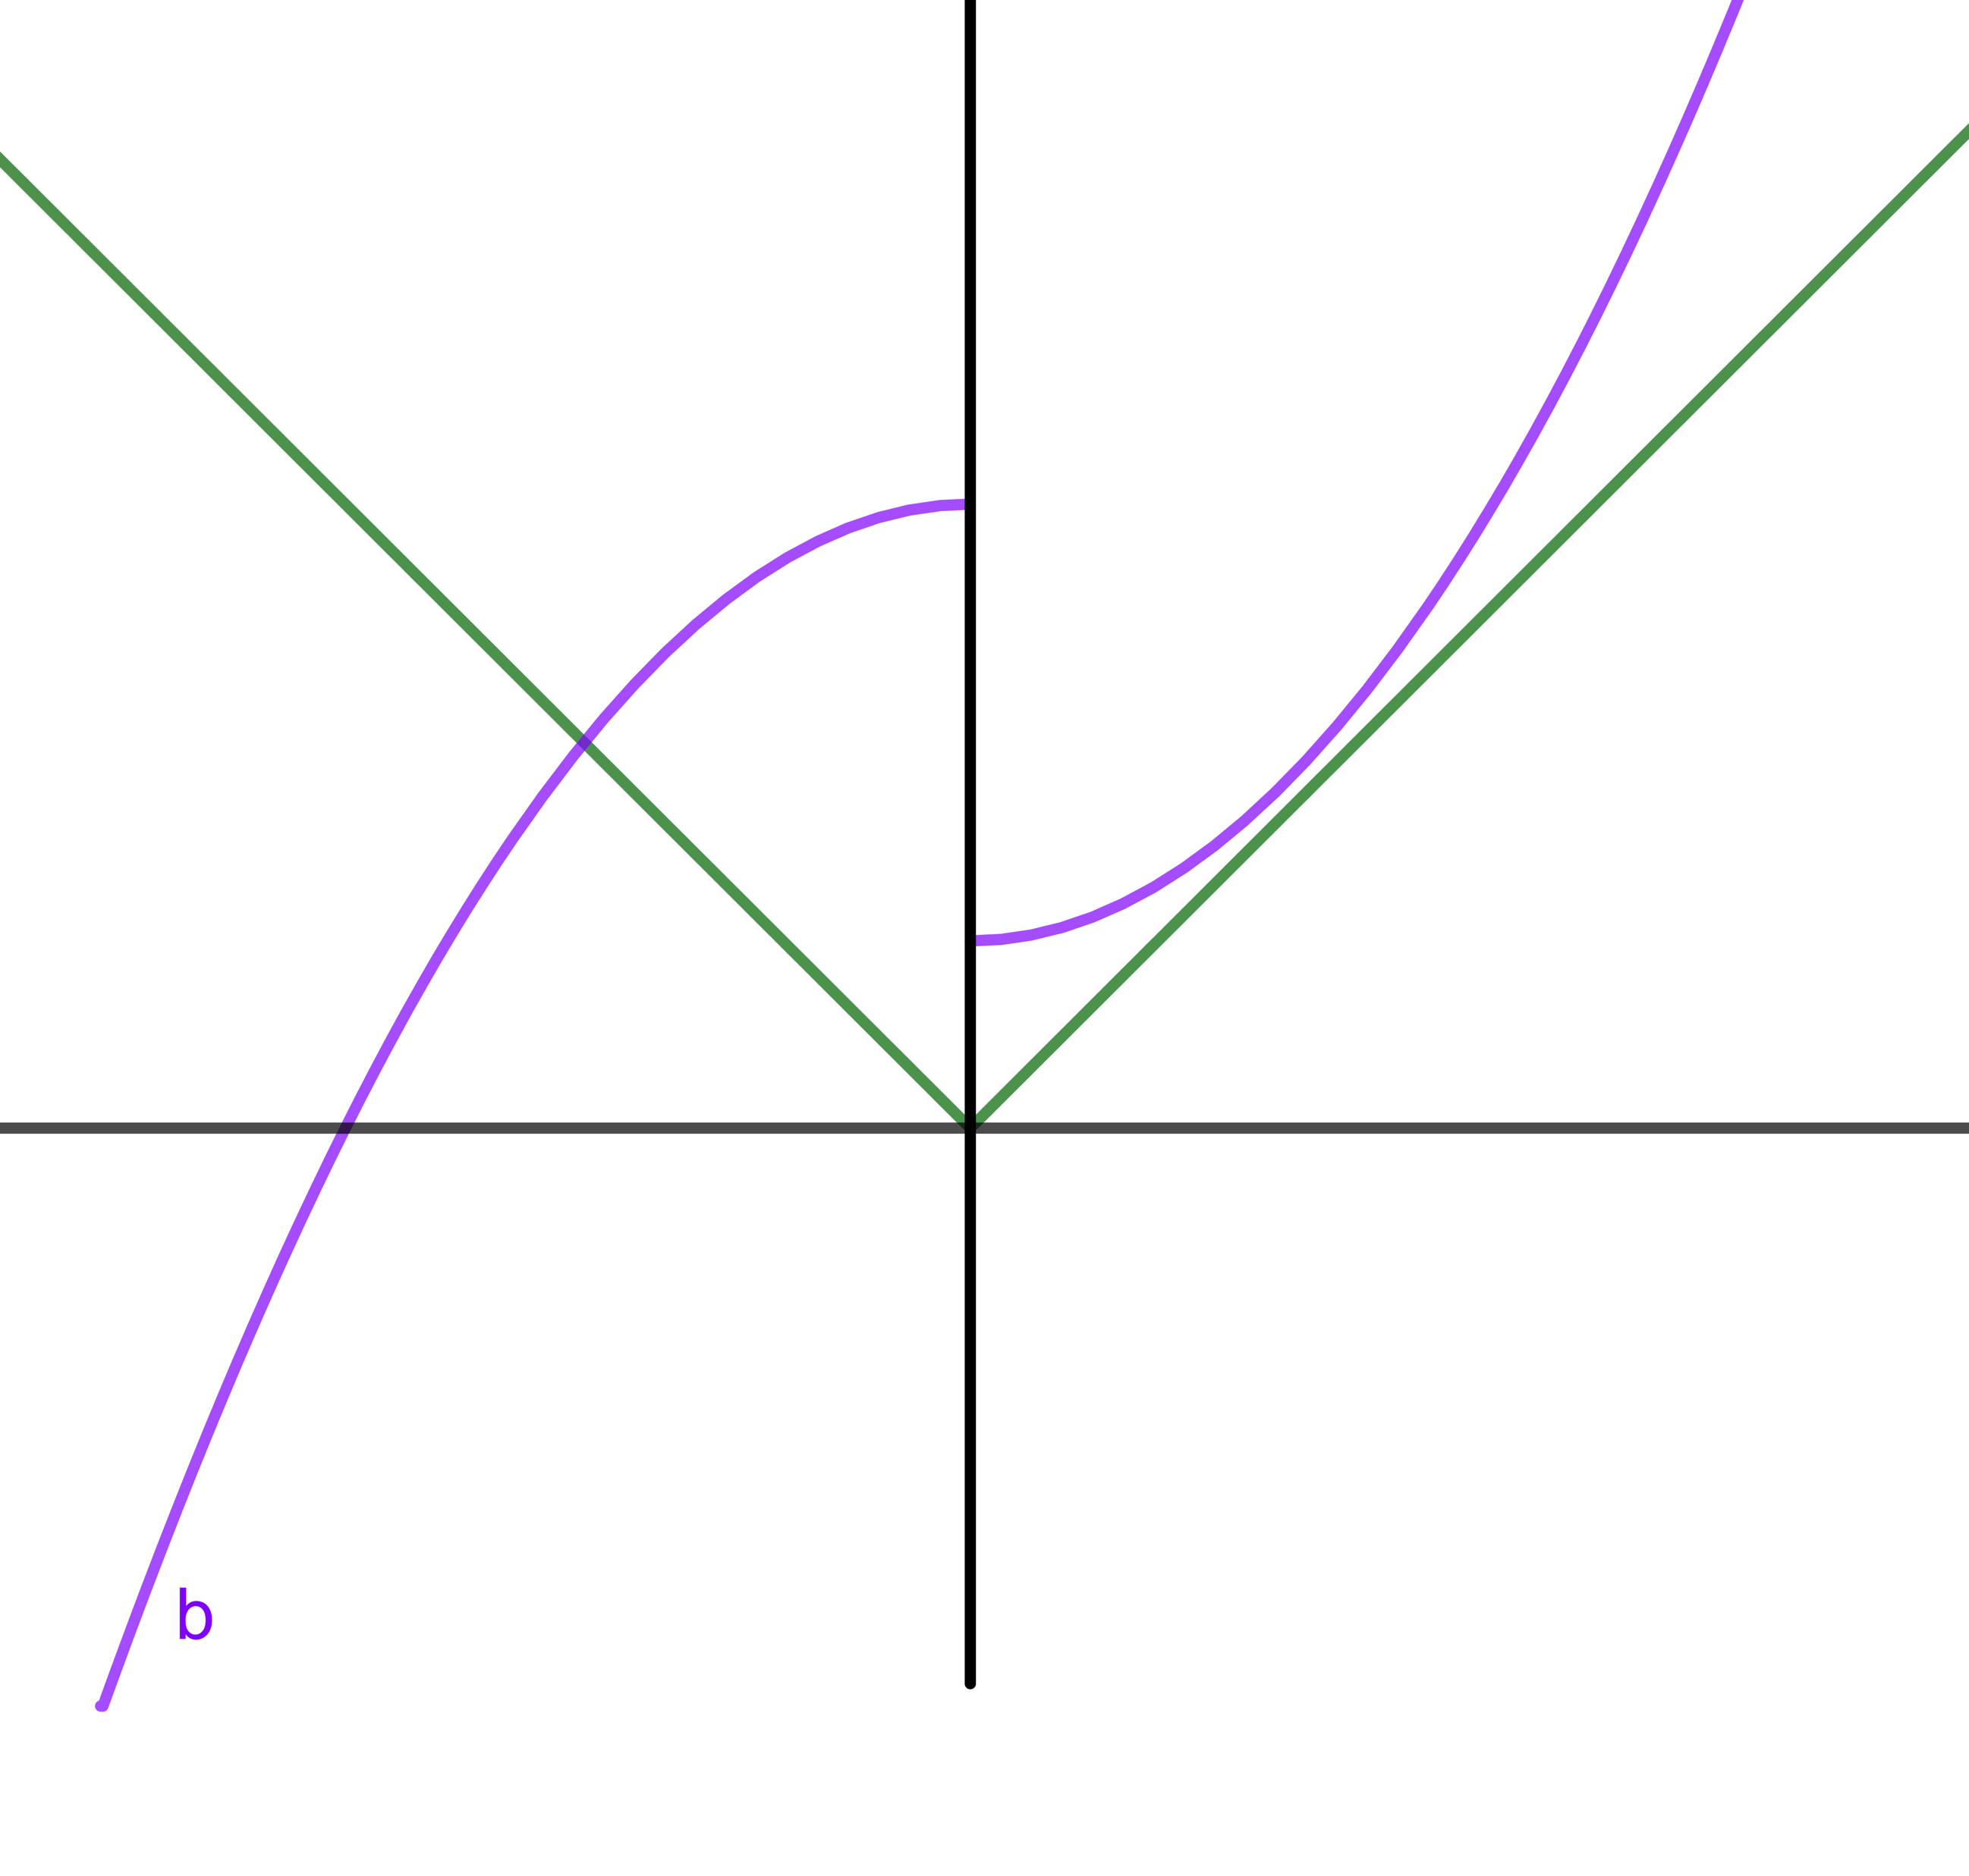
Antiderivative: definition
Remember:
$${\left(∫f\left(x\right)dx\right)}^{′}=f(x)$$
Thus indefinite integral must be differentiable at every point of the domain of the function $f\left(x\right)!$
Example: $f\left(x\right)=|x|$

Slide 13
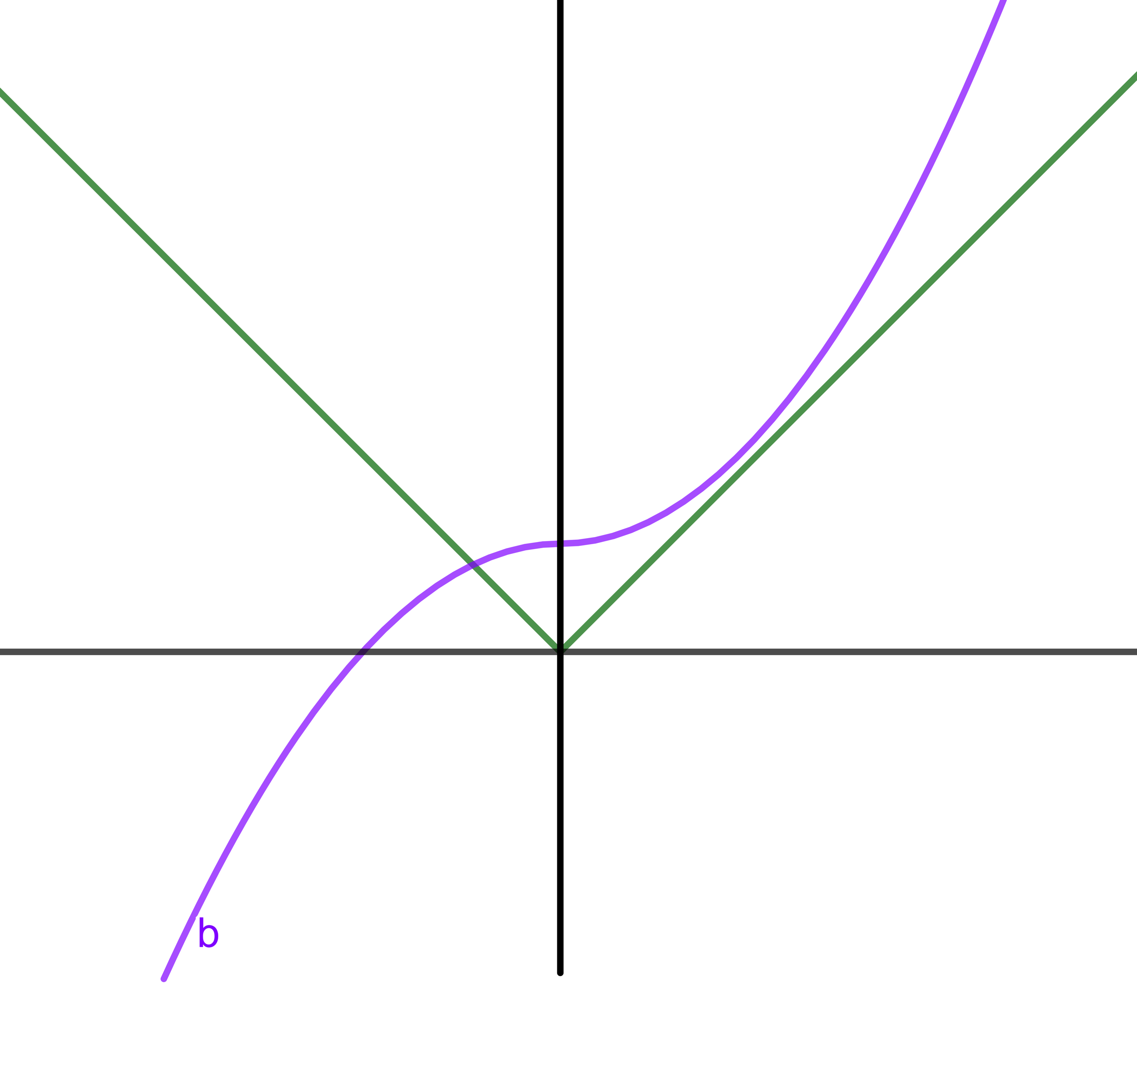
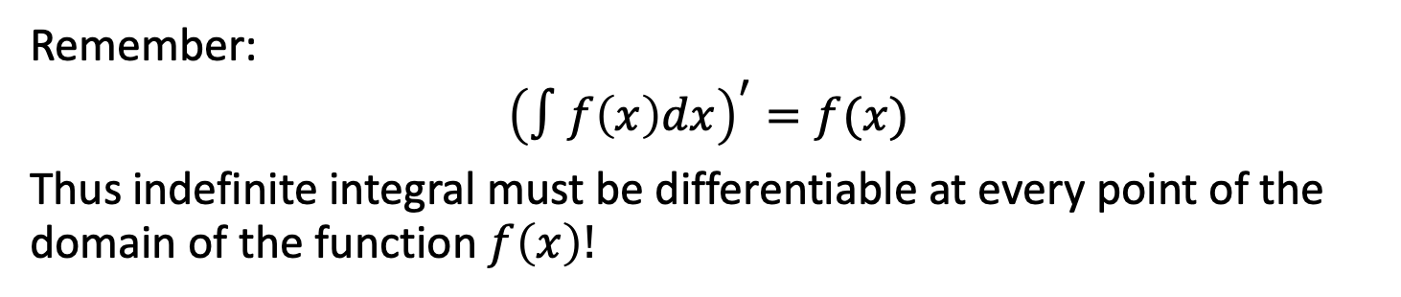
Antiderivative: definition
Remember:
$${\left(∫f\left(x\right)dx\right)}^{′}=f(x)$$
Thus indefinite integral must be differentiable at every point of the domain of the function $f\left(x\right)!$
Example: $f\left(x\right)=|x|$

Slide 14
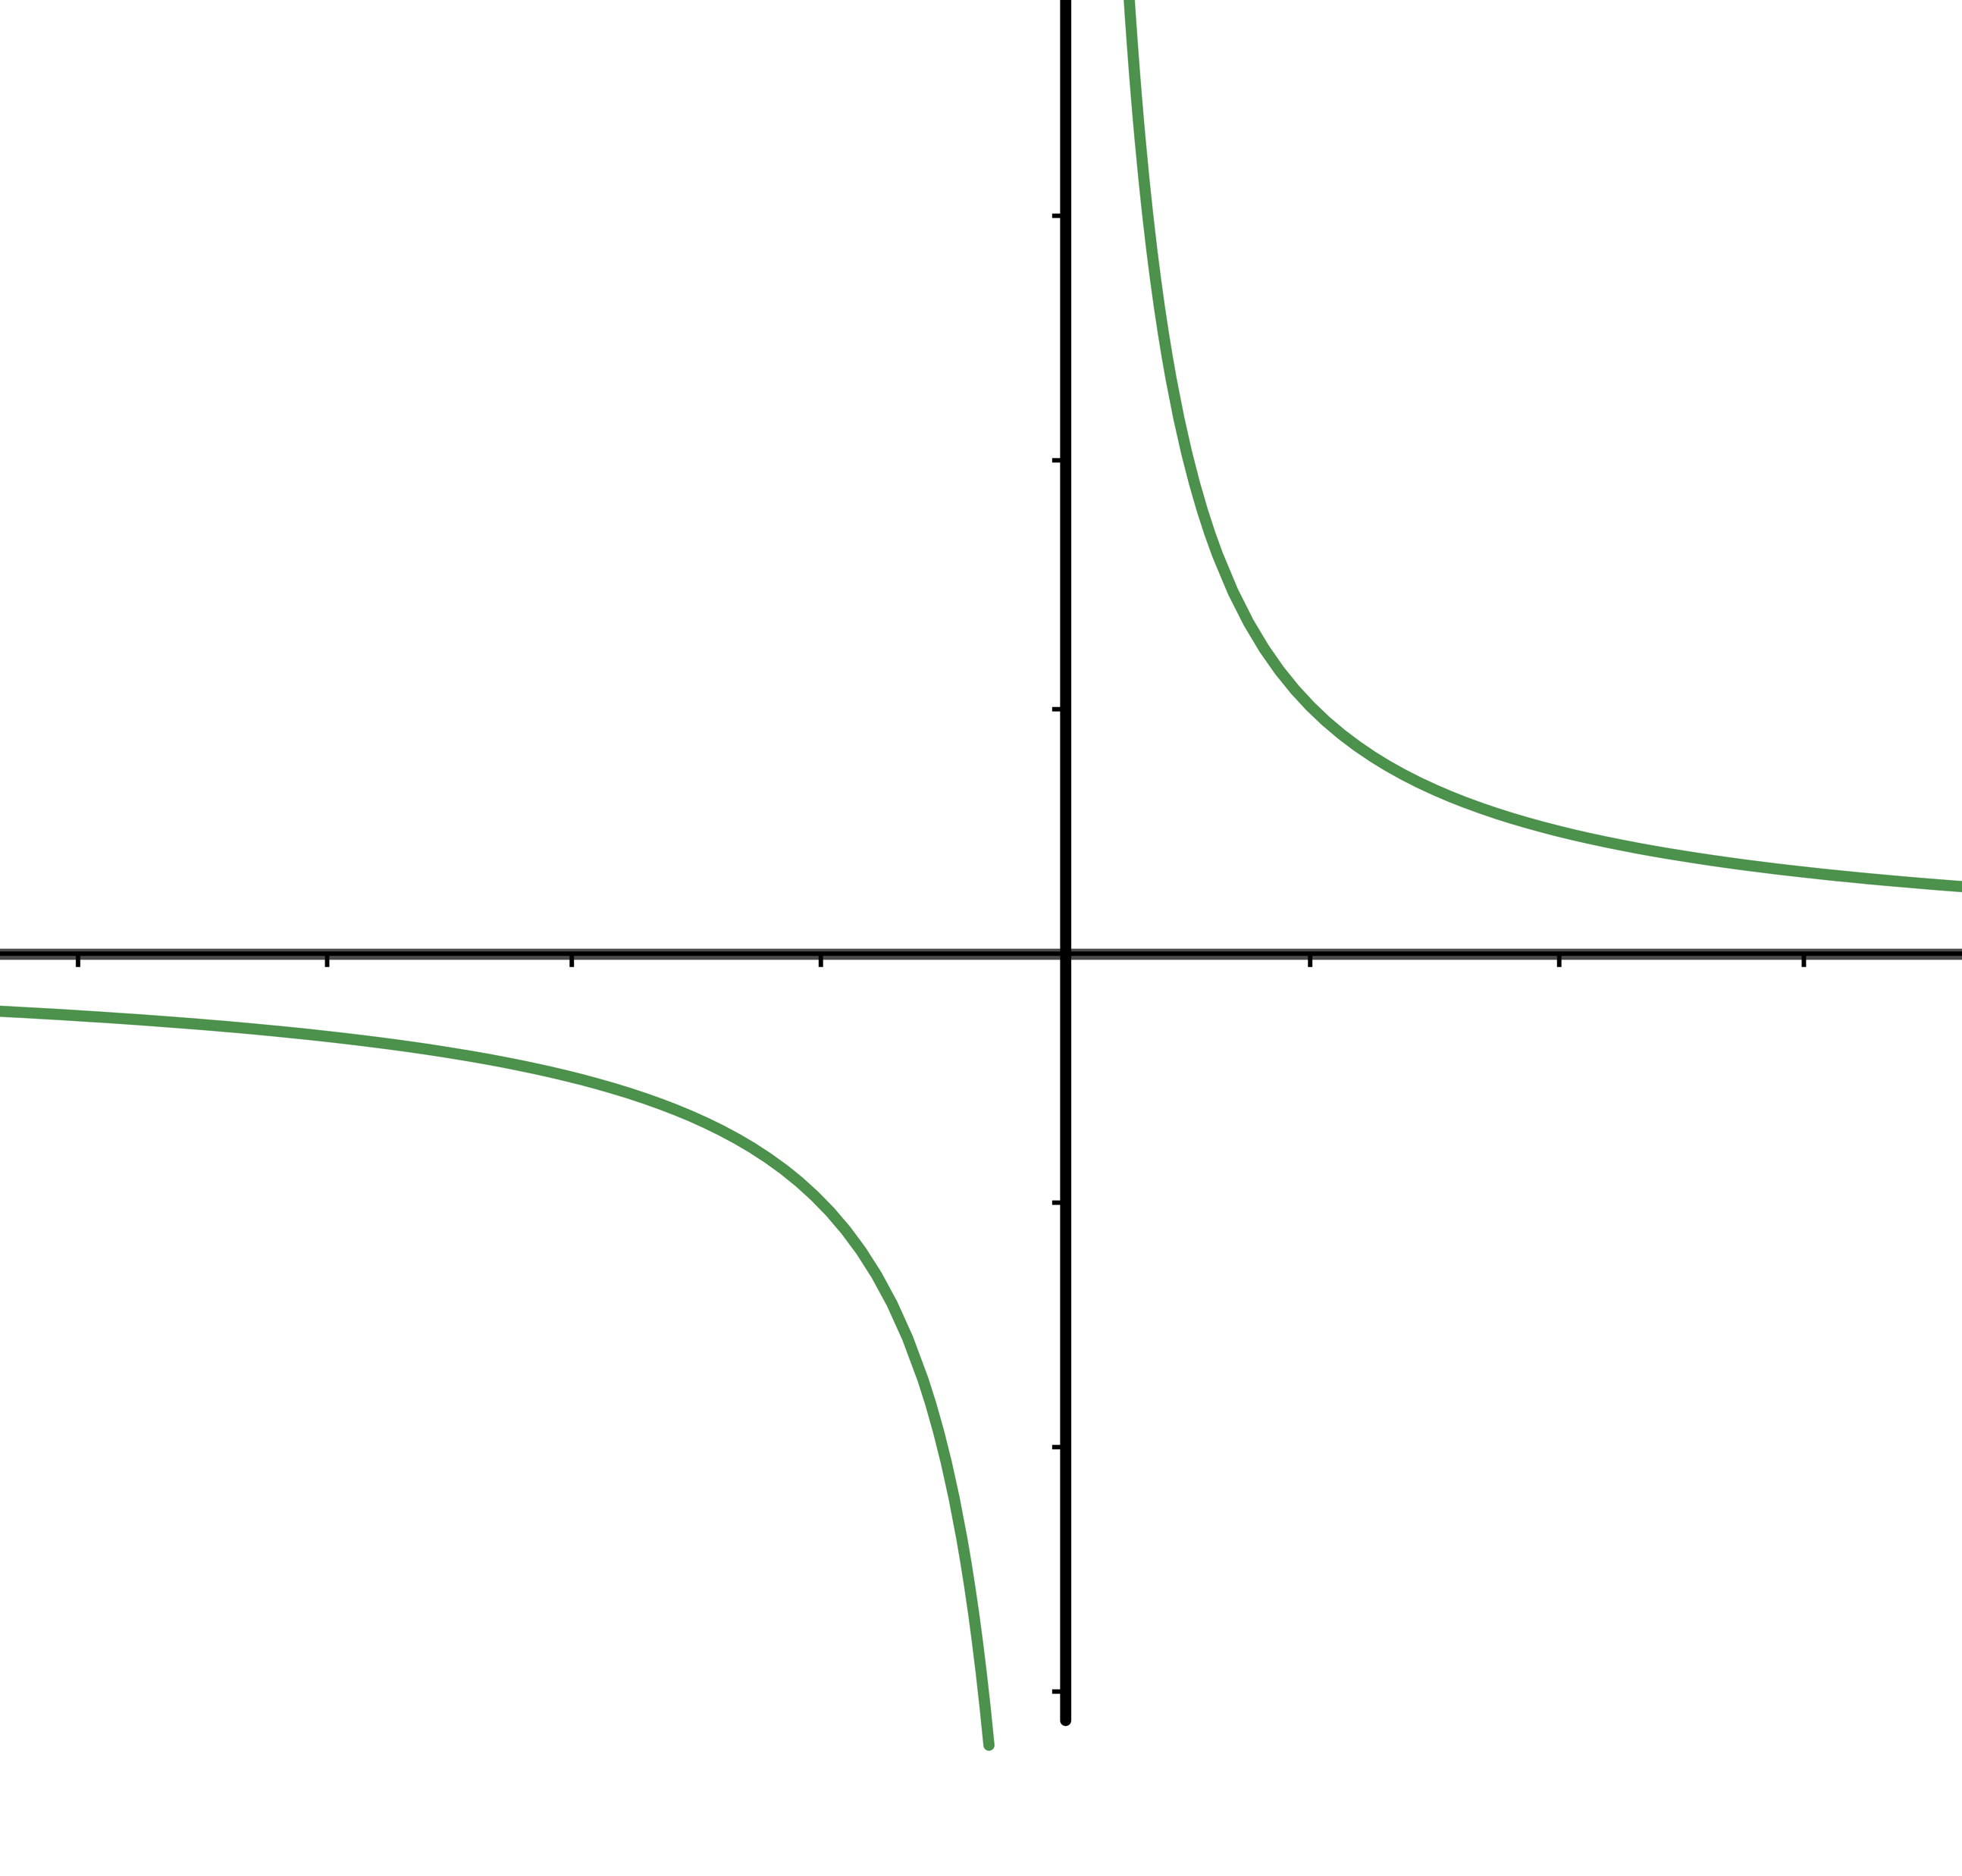

Antiderivative: definition
Remember:
$${\left(∫f\left(x\right)dx\right)}^{′}=f(x)$$
Thus indefinite integral must be differentiable at every point of the domain of the function $f\left(x\right)!$
Example: $f\left(x\right)=1/x$

Slide 15
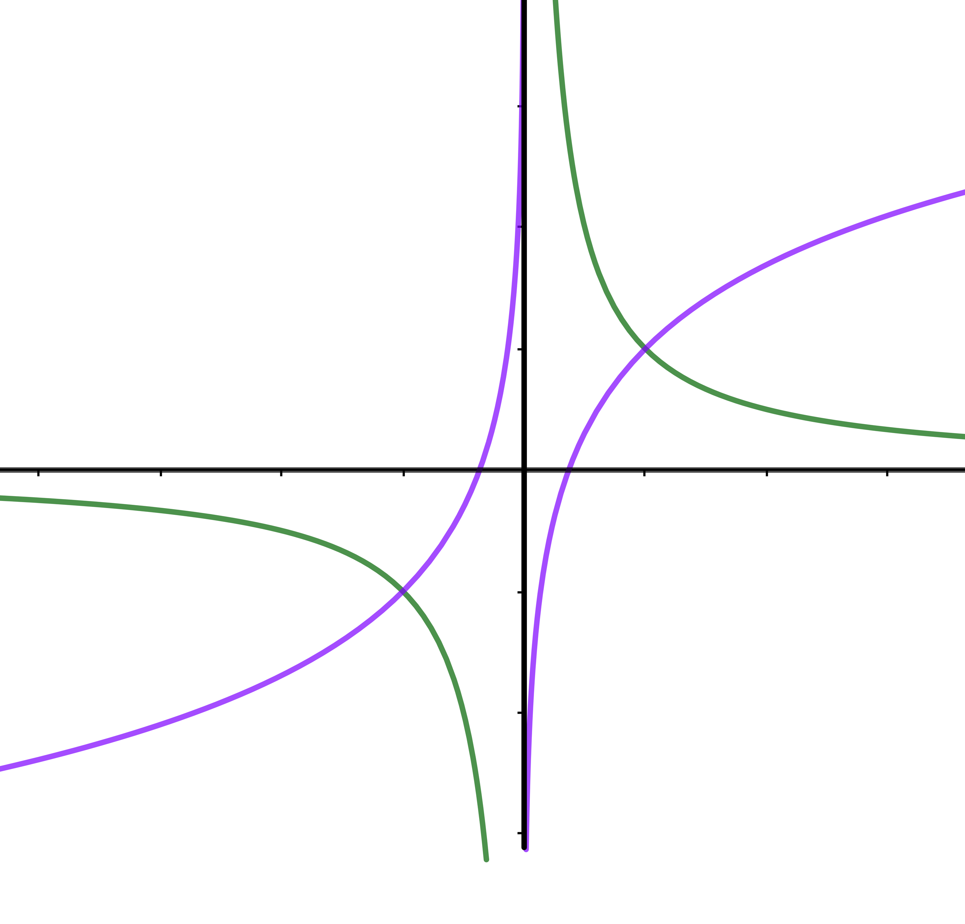
Antiderivative: definition
Remember:
$${\left(∫f\left(x\right)dx\right)}^{′}=f(x)$$
Thus indefinite integral must be differentiable at every point of the domain of the function $f\left(x\right)!$
Example: $f\left(x\right)=1/x$

Slide 16
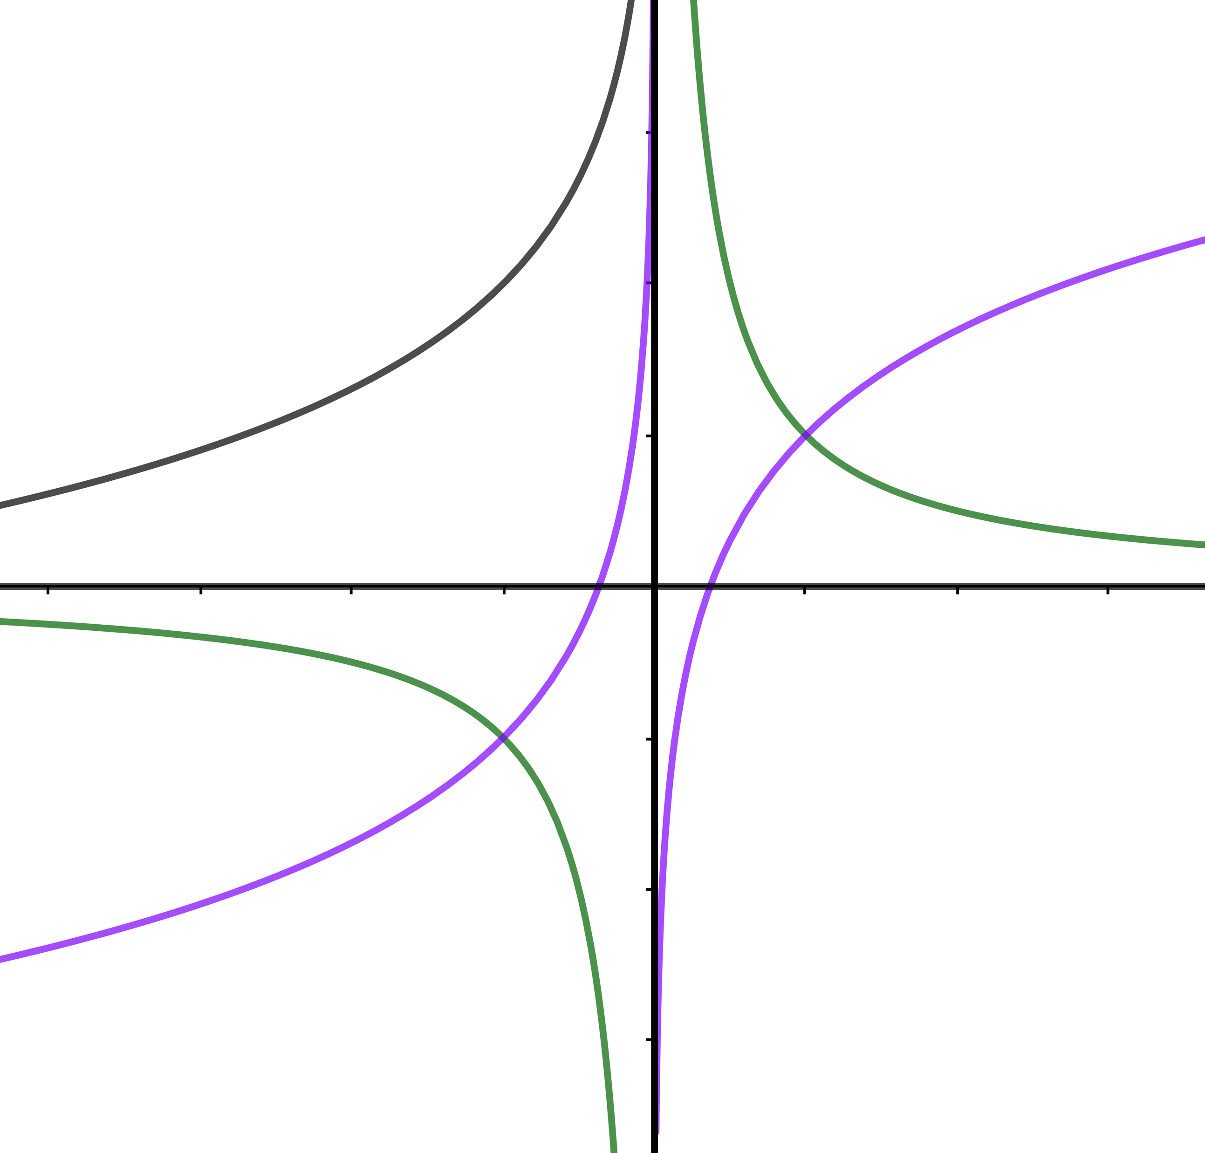
Antiderivative: definition
Remember:
$${\left(∫f\left(x\right)dx\right)}^{′}=f(x)$$
Thus indefinite integral must be differentiable at every point of the domain of the function $f\left(x\right)!$
Example: $f\left(x\right)=1/x$

Slide 17
РОЛИКИ ПРО ЗАМЕНУ ПЕРЕМЕННЫХ И ИНТЕГРИРОВАНИЕ ПО ЧАСТЯМ УХОДЯТ НА ДОСКУ

Slide 18
Antiderivative: integrability in elementary functions
Remember: by our arithmetic rules and all-mighty chain rule we could take a derivative from any elementary function.
Is it the case for integration?

Slide 19
Antiderivative: integrability in elementary functions
Remember: by our arithmetic rules and all-mighty chain rule we could take a derivative from any elementary function.
Is it the case for integration?
It’s not!
Function is called integrable in elementary functions, if its indefinite integral can be written by the finite number of arithmetic operation and compositions of elementary functions (remember our first week!).

Slide 20
Antiderivative: integrability in elementary functions
Remember: by our arithmetic rules and all-mighty chain rule we could take a derivative from any elementary function.
Is it the case for integration?
It’s not!
Function is called integrable in elementary functions, if its indefinite integral can be written by the finite number of arithmetic operation and compositions of elementary functions (remember our first week!).
It does not mean that such functions do not have the indefinite integral! They actually do, but we cannot write it in the form above.

Slide 21
Antiderivative: integrability in elementary functions
Remember: by our arithmetic rules and all-mighty chain rule we could take a derivative from any elementary function.
Is it the case for integration?
It’s not!
Function is called integrable in elementary functions, if its indefinite integral can be written by the finite number of arithmetic operation and compositions of elementary functions (remember our first week!).
It does not mean that such functions do not have the indefinite integral! They actually do, but we cannot write it in the form above.
Examples: $f\left(x\right)=e^{−x^{2}}$, $f\left(x\right)=\sin{x^{2}}$, $f\left(x\right)=\sin{x}/x$ and others.

Slide 22
Antiderivative: integrability in elementary functions
So, if there are functions which are non-integrable in elementary functions, can we somehow guarantee that certain functions are definitely integrable in elementary functions?

Slide 23
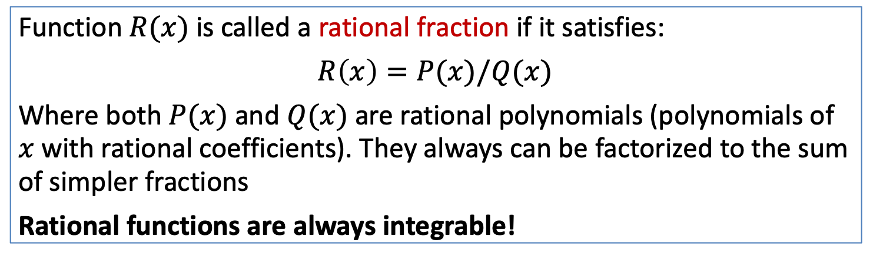
Antiderivative: integrability in elementary functions
So, if there are functions which are non-integrable in elementary functions, can we somehow guarantee that certain functions are definitely integrable in elementary functions?
Function $R(x)$ is called a rational fraction if it satisfies:
$$R\left(x\right)=P(x)/Q(x)$$
Where both $P(x)$ and $Q(x)$ are rational polynomials (polynomials of $x$ with rational coefficients). They always can be factorized to the sum of simpler fractions
Rational functions are always integrable!

Slide 24
Antiderivative: integrability in elementary functions
So, if there are functions which are non-integrable in elementary functions, can we somehow guarantee that certain functions are definitely integrable in elementary functions?
Function $R(x)$ is called a rational fraction if it satisfies:
$$R\left(x\right)=P(x)/Q(x)$$
Where both $P(x)$ and $Q(x)$ are rational polynomials (polynomials of $x$ with rational coefficients). They always can be factorized to the sum of simpler fractions
Rational functions are always integrable!
Examples: let us find $∫dx/(1−x^{2})$

Slide 25
Antiderivative: integrability in elementary functions
So, if there are functions which are non-integrable in elementary functions, can we somehow guarantee that certain functions are definitely integrable in elementary functions?
Function $R(x)$ is called a rational fraction if it satisfies:
$$R\left(x\right)=P(x)/Q(x)$$
Where both $P(x)$ and $Q(x)$ are rational polynomials (polynomials of $x$ with rational coefficients). They always can be factorized to the sum of simpler fractions
Rational functions are always integrable!
Examples: let us find $∫dx/(1−x^{2})$
The full procedure is rather complicated. You can find whole algorithm in the section of additional materials to this week!

Slide 26
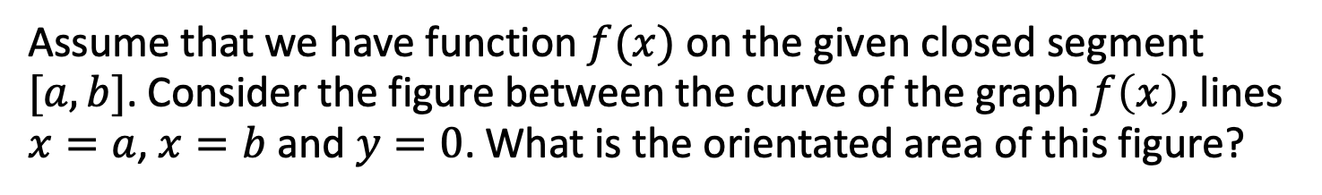
Definite integral
Assume that we have function $f(x)$ on the given closed segment $[a,b]$. Consider the figure between the curve of the graph $f\left(x\right)$, lines $x=a$, $x=b$ and $y=0$. What is the orientated area of this figure?
f(x)
a
b

Slide 27
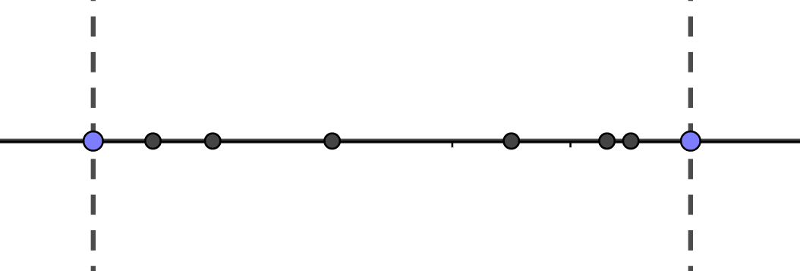
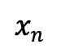
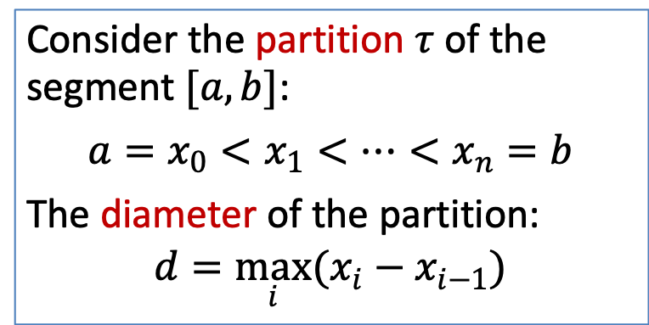
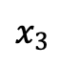
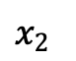
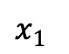
Definite integral
Assume that we have function $f(x)$ on the given closed segment $[a,b]$. Consider the figure between the curve of the graph $f\left(x\right)$, lines $x=a$, $x=b$ and $y=0$. What is the orientated area of this figure?
Consider the partition $τ$ of the segment $[a,b]$:
$$a=x_{0}<x_{1}<…<x_{n}=b$$
The diameter of the partition:
$$d=\max_{i}{(x_{i}−x_{i−1})}$$
a
$x_{1}$
$x_{2}$
$x_{3 }$
$x_{n}$
b

Slide 28
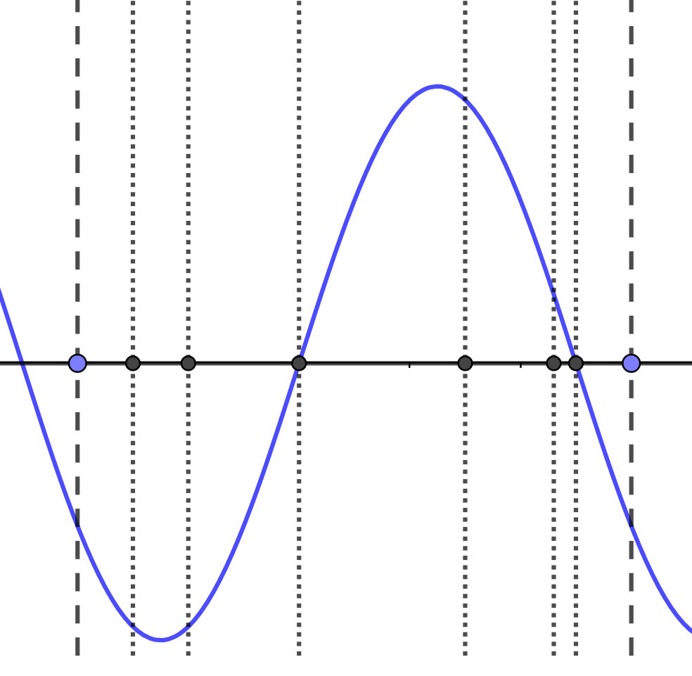
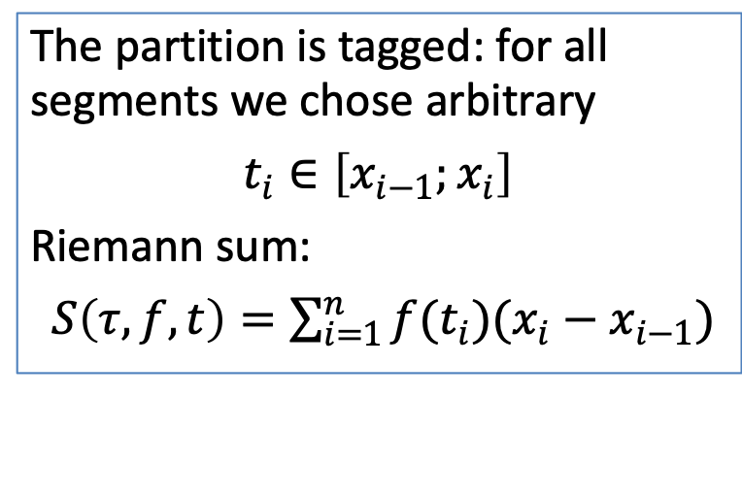
Definite integral
Assume that we have function $f(x)$ on the given closed segment $[a,b]$. Consider the figure between the curve of the graph $f\left(x\right)$, lines $x=a$, $x=b$ and $y=0$. What is the orientated area of this figure?
Consider the partition $τ$ of the segment $[a,b]$:
$$a=x_{0}<x_{1}<…<x_{n}=b$$
The diameter of the partition:
$$d=\max_{i}{(x_{i}−x_{i−1})}$$
a
b
The partition is tagged: for all segments we chose arbitrary
$$t_{i}∈\left[x_{i−1};x_{i}\right]$$
Riemann sum:
$S\left(τ,f,t\right)=\sum_{i=1}^{n}{f(t_{i})(x_{i}−x_{i−1})}$

Slide 29
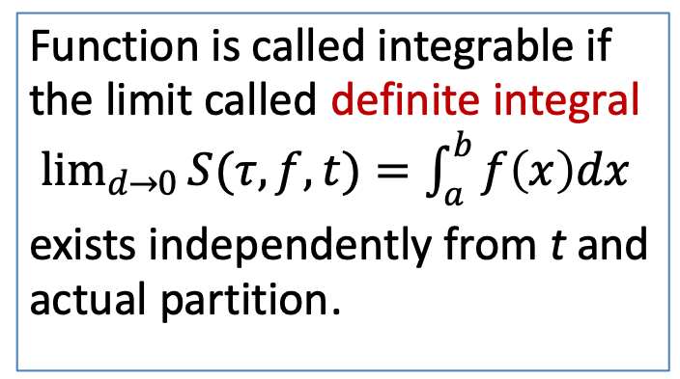
Definite integral
Assume that we have function $f(x)$ on the given closed segment $[a,b]$. Consider the figure between the curve of the graph $f\left(x\right)$, lines $x=a$, $x=b$ and $y=0$. What is the orientated area of this figure?
Consider the partition $τ$ of the segment $[a,b]$:
$$a=x_{0}<x_{1}<…<x_{n}=b$$
The diameter of the partition:
$$d=\max_{i}{(x_{i}−x_{i−1})}$$
a
b
The partition is tagged: for all segments we chose arbitrary
$$t_{i}∈\left[x_{i−1};x_{i}\right]$$
Riemann sum:
$S\left(τ,f,t\right)=\sum_{i=1}^{n}{f(t_{i})(x_{i}−x_{i−1})}$
Function is called integrable if the limit called definite integral
$\lim_{d→0}{S(τ,f,t)}=\int_{a}^{b}{f\left(x\right)dx}$
exists independently from t and actual partition.

Slide 30
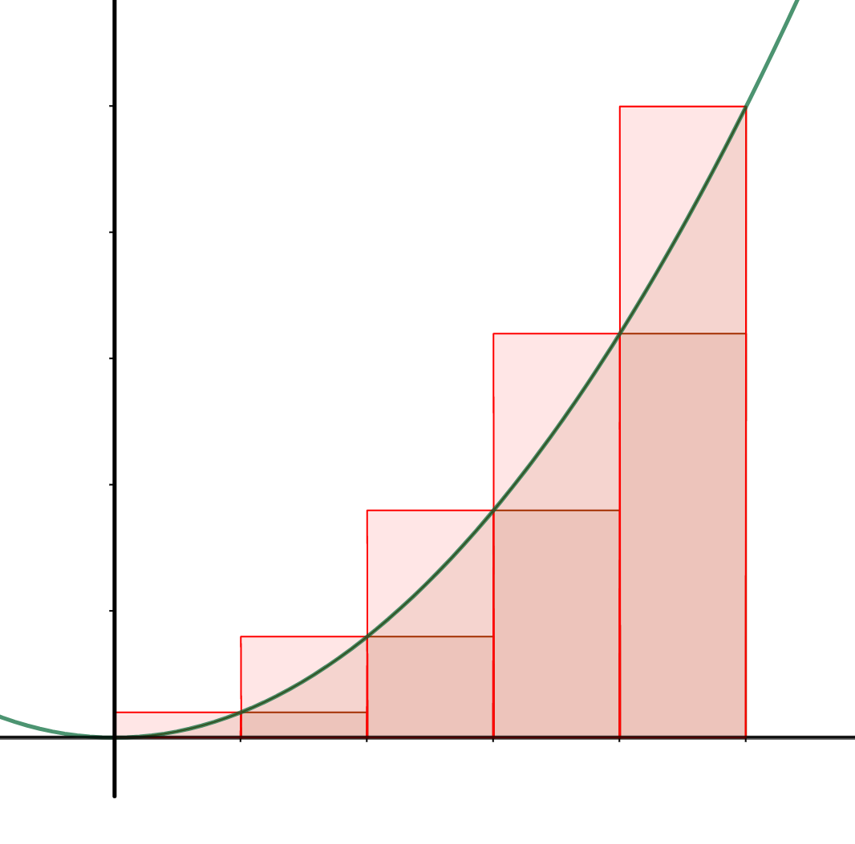
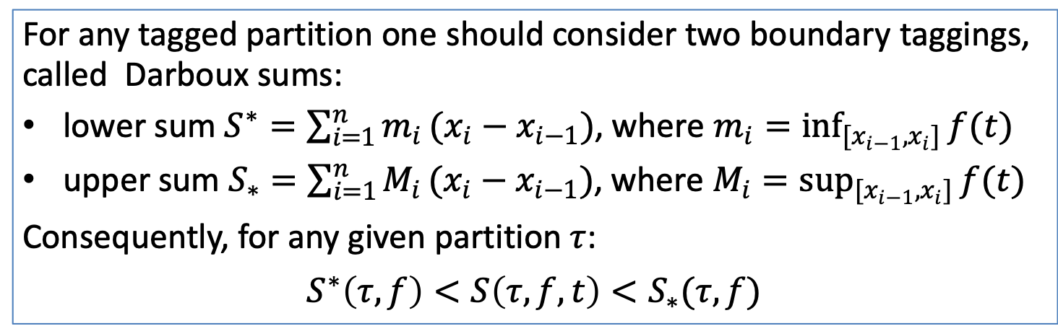
Definite integral
For any tagged partition one should consider two boundary taggings, called Darboux sums:
lower sum $S^{∗}=\sum_{i=1}^{n}{m_{i}}(x_{i}−x_{i−1})$, where $m_{i}=\inf_{[x_{i−1},x_{i}]}{f(t)}$
upper sum $S_{∗}^{ }=\sum_{i=1}^{n}{M_{i}}(x_{i}−x_{i−1})$, where $M_{i}=\sup_{[x_{i−1},x_{i}]}{f(t)}$
Consequently, for any given partition $τ$:
$$S^{∗}\left(τ, f\right)<S\left(τ,f,t\right)<S_{∗}(τ,f)$$

Slide 31
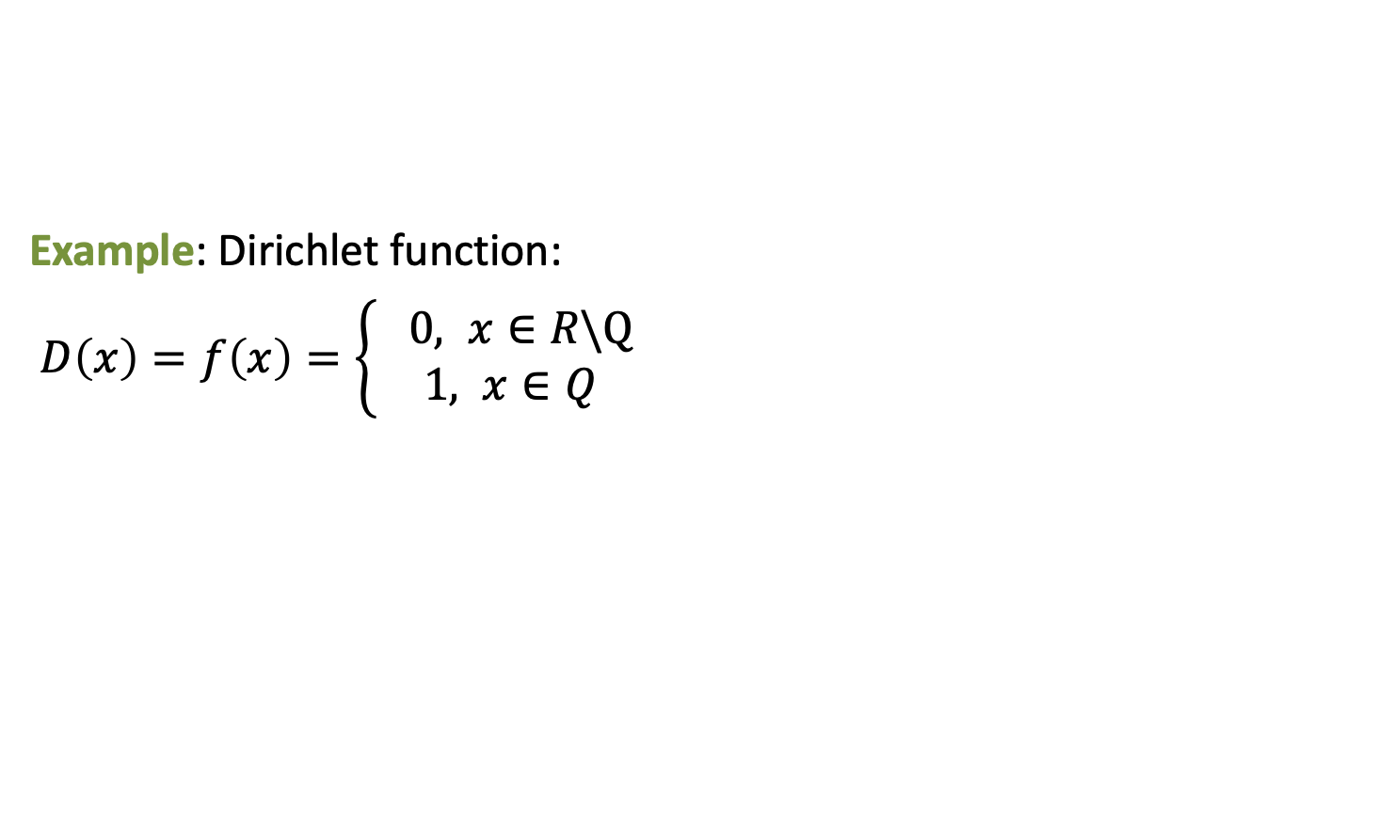
Definite integral
For any tagged partition one should consider two boundary taggings, called Darboux sums:
lower sum $S^{∗}=\sum_{i=1}^{n}{m_{i}}(x_{i}−x_{i−1})$, where $m_{i}=\inf_{[x_{i−1},x_{i}]}{f(t)}$
upper sum $S_{∗}^{ }=\sum_{i=1}^{n}{M_{i}}(x_{i}−x_{i−1})$, where $M_{i}=\sup_{[x_{i−1},x_{i}]}{f(t)}$
Consequently, for any given partition $τ$:
$$S^{∗}\left(τ, f\right)<S\left(τ,f,t\right)<S_{∗}(τ,f)$$
Example: Dirichlet function:
$D\left(x\right)=f\left(x\right)=\left\{\begin{aligned} 0, x∈R\backslash Q \\ 1, x∈Q\end{aligned}\right.$

Slide 32

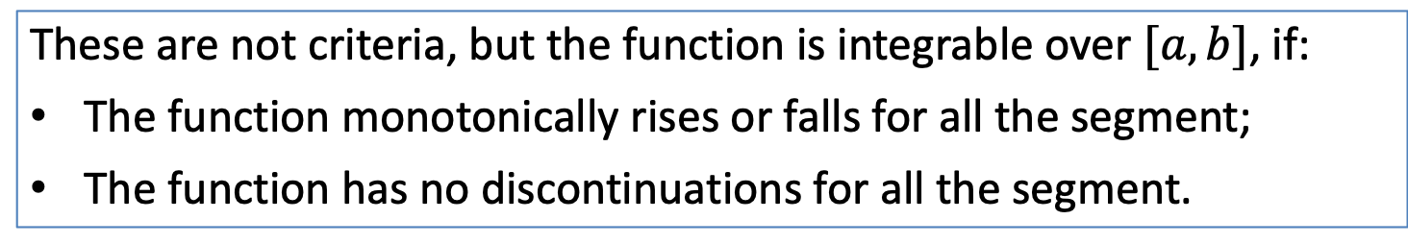
Definite integral
If we showed that you can easily come up with non-integrable function, the right idea is to provide a couple of sufficient conditions for integrability.
These are not criteria, but the function is integrable over $[a, b]$, if:
The function monotonically rises or falls for all the segment;
The function has no discontinuations for all the segment.
Example: $f\left(x\right)=x^{2}$, $\left[a,b\right]=[0, 1]$

Slide 33
Fundamental theorem of calculus
Once again we should state that nobody uses the definition. Instead, we are going to introduce the connection between indefinite and definite integrals here:

Slide 34
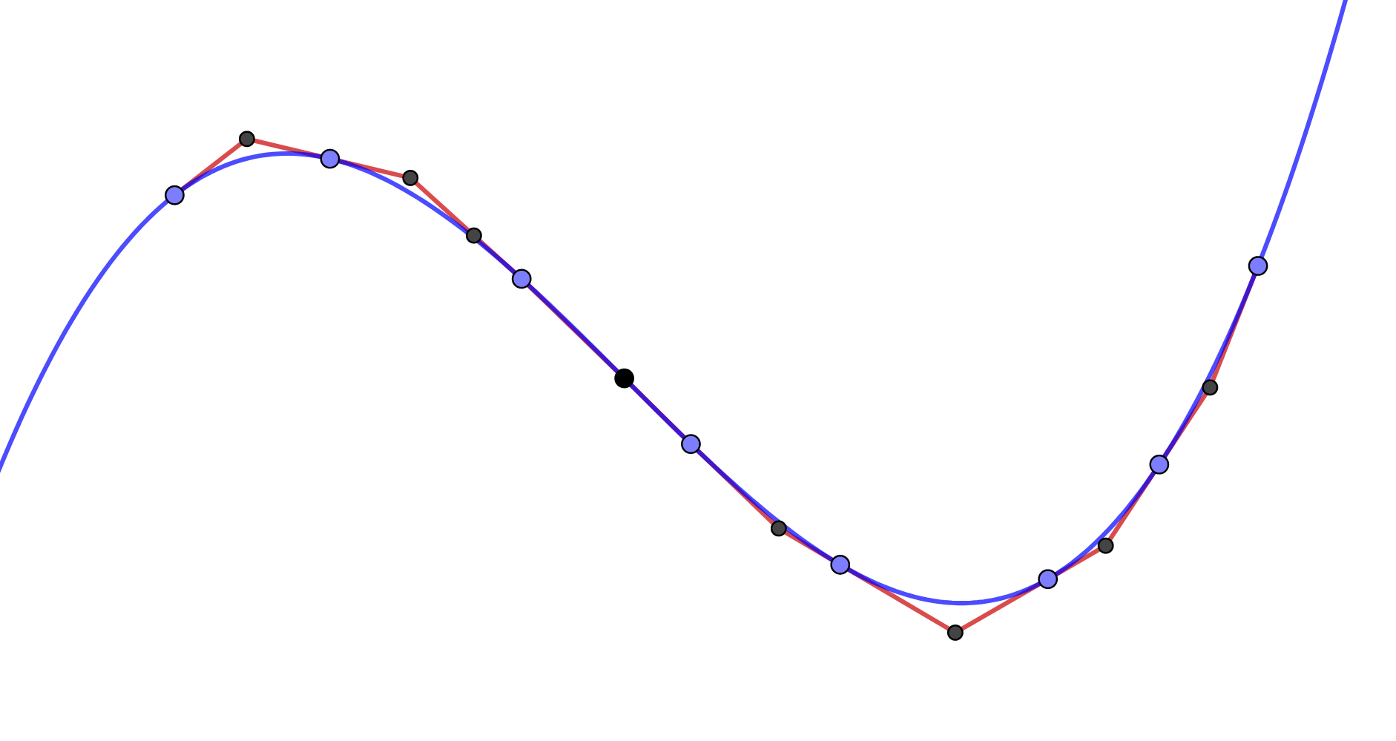
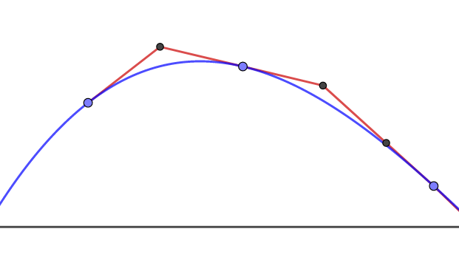
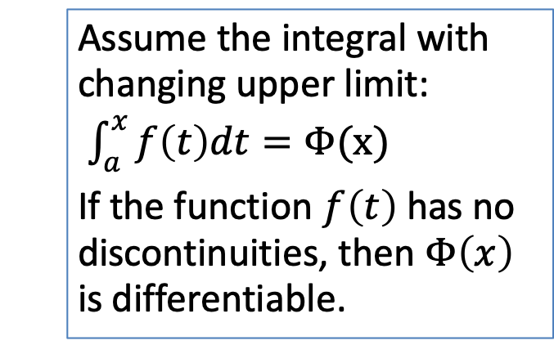
Fundamental theorem of calculus
Once again we should state that nobody uses the definition. Instead, we are going to introduce the connection between indefinite and definite integrals here:
Assume the integral with changing upper limit:
$\int_{a}^{x}{f\left(t\right)dt}=Φ(x)$
If the function $f\left(t\right)$ has no discontinuities, then $Φ\left(x\right)$ is differentiable.

Slide 35
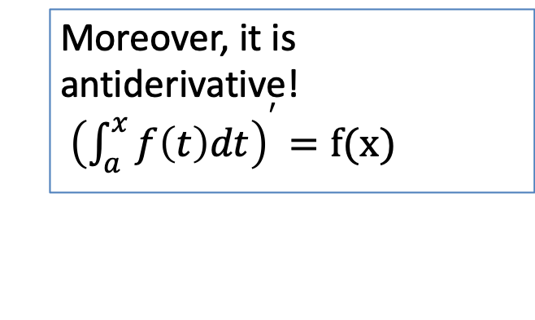
Fundamental theorem of calculus
Once again we should state that nobody uses the definition. Instead, we are going to introduce the connection between indefinite and definite integrals here:
Assume the integral with changing upper limit:
$\int_{a}^{x}{f\left(t\right)dt}=Φ(x)$
If the function $f\left(t\right)$ has no discontinuities, then $Φ\left(x\right)$ is differentiable.
Moreover, it is antiderivative!
${\left(\int_{a}^{x}{f\left(t\right)dt}\right)}^{′}=f(x)$

Slide 36
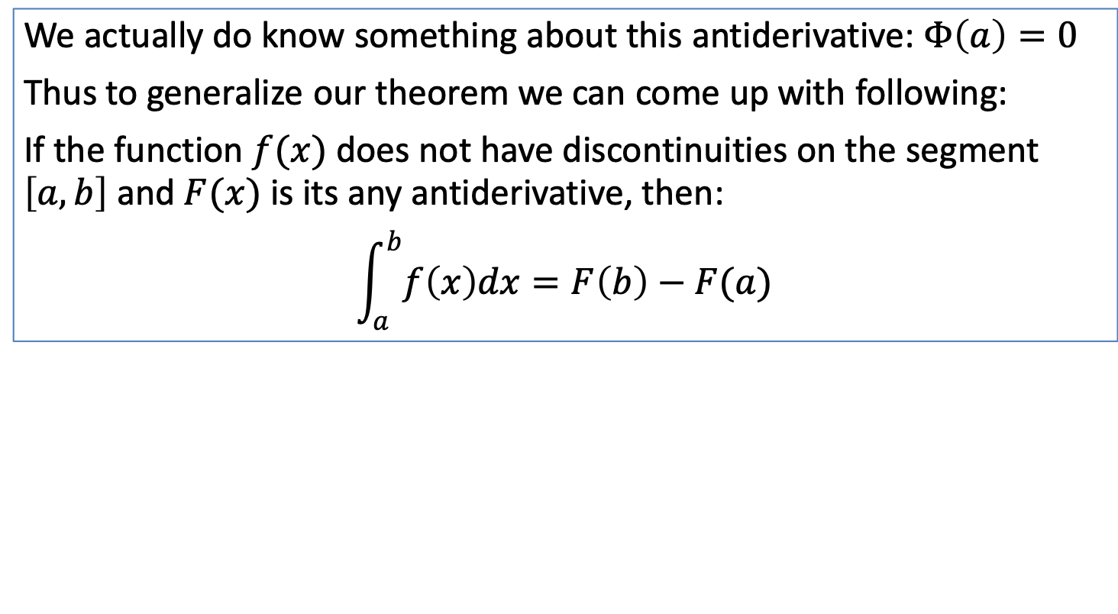

Fundamental theorem of calculus
Take a look at our integral: $\int_{a}^{b}{f\left(t\right)dt=Φ(b)}$.
That’s nice, but what antiderivative it is exactly? Remember: they all differ by constant shift!
We actually do know something about this antiderivative: $Φ\left(a\right)=0$
Thus to generalize our theorem we can come up with following:
If the function $f(x)$ does not have discontinuities on the segment $\left[a, b\right]$ and $F(x)$ is its any antiderivative, then:
$$\int_{a}^{b}{f\left(x\right)dx=F\left(b\right)−F(a)}$$
Example:

Slide 37
РОЛИК С ДОСКОЙ

Slide 38
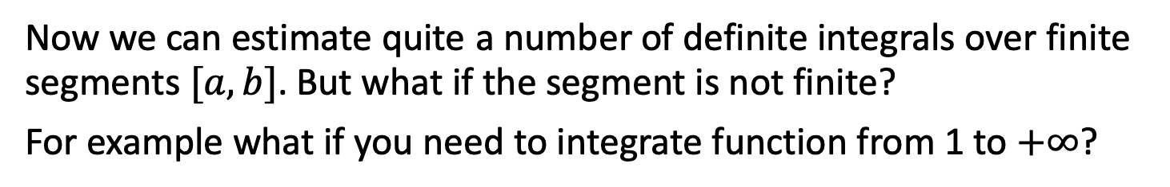
Definite integral: improper integrals
Now we can estimate quite a number of definite integrals over finite segments $[a,b]$. But what if the segment is not finite?
For example what if you need to integrate function from 1 to $+∞$?

Slide 39
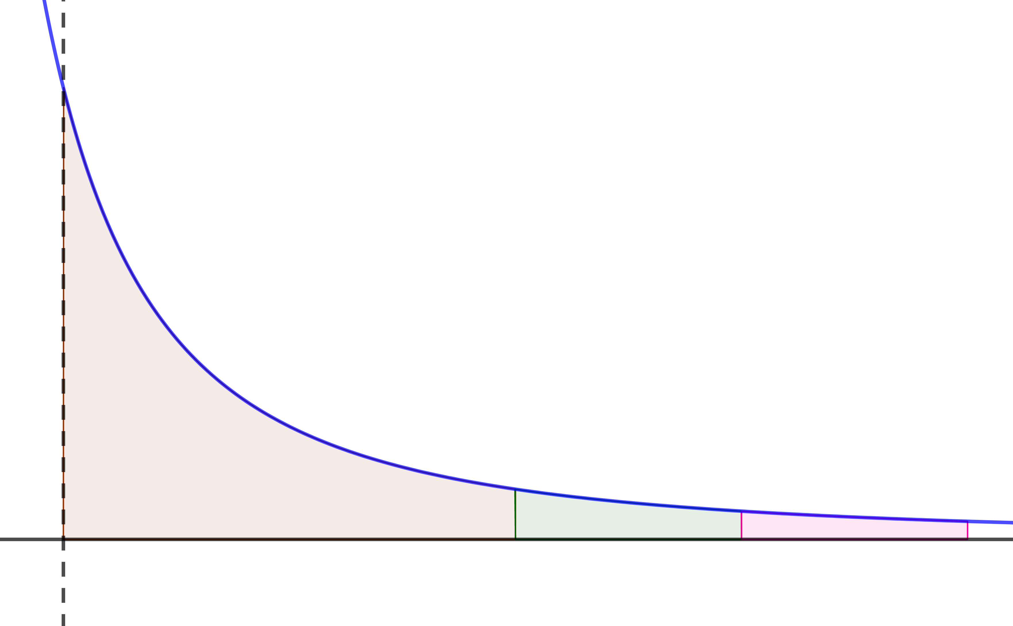
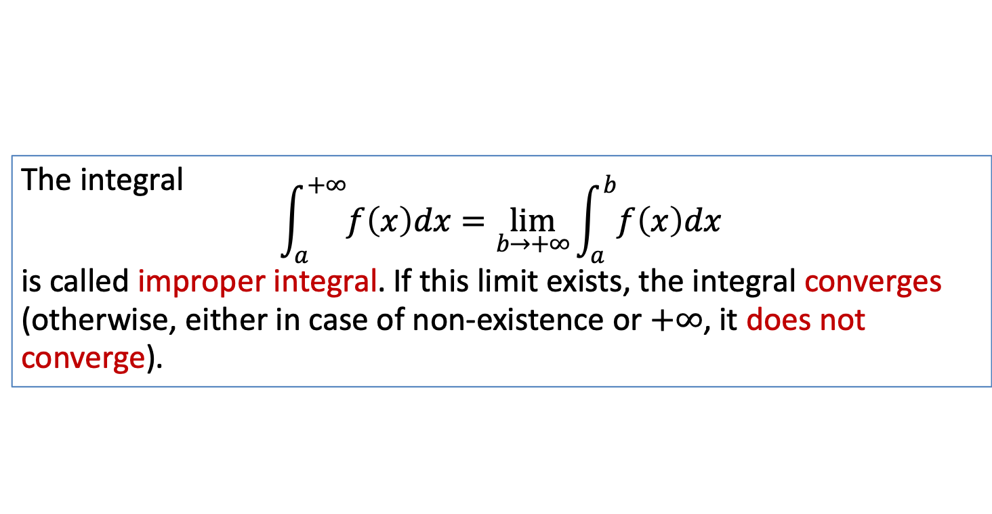
Definite integral: improper integrals
Now we can estimate quite a number of definite integrals over finite segments $[a,b]$. But what if the segment is not finite?
For example what if you need to integrate function from 1 to $+∞$?
The integral
$$\int_{a}^{+∞}{f\left(x\right)dx}=\lim_{b→+∞}{\int_{a}^{b}{f\left(x\right)dx}}$$
is called improper integral. If this limit exists, the integral converges (otherwise, either in case of non-existence or $+∞$, it does not converge).
f(x)
a

Slide 40
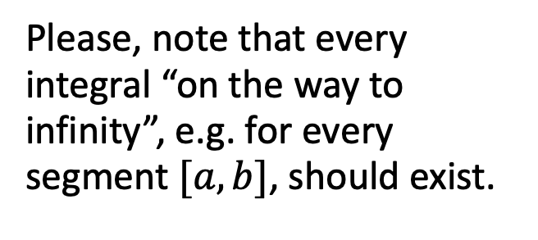
Definite integral: improper integrals
Now we can estimate quite a number of definite integrals over finite segments $[a,b]$. But what if the segment is not finite?
For example what if you need to integrate function from 1 to $+∞$?
The integral
$$\int_{a}^{+∞}{f\left(x\right)dx}=\lim_{b→+∞}{\int_{a}^{b}{f\left(x\right)dx}}$$
is called improper integral. If this limit exists, the integral converges (otherwise, either in case of non-existence or $+∞$, it does not converge).
Please, note that every integral “on the way to infinity”, e.g. for every segment $[a,b]$, should exist.
f(x)
a

Slide 41
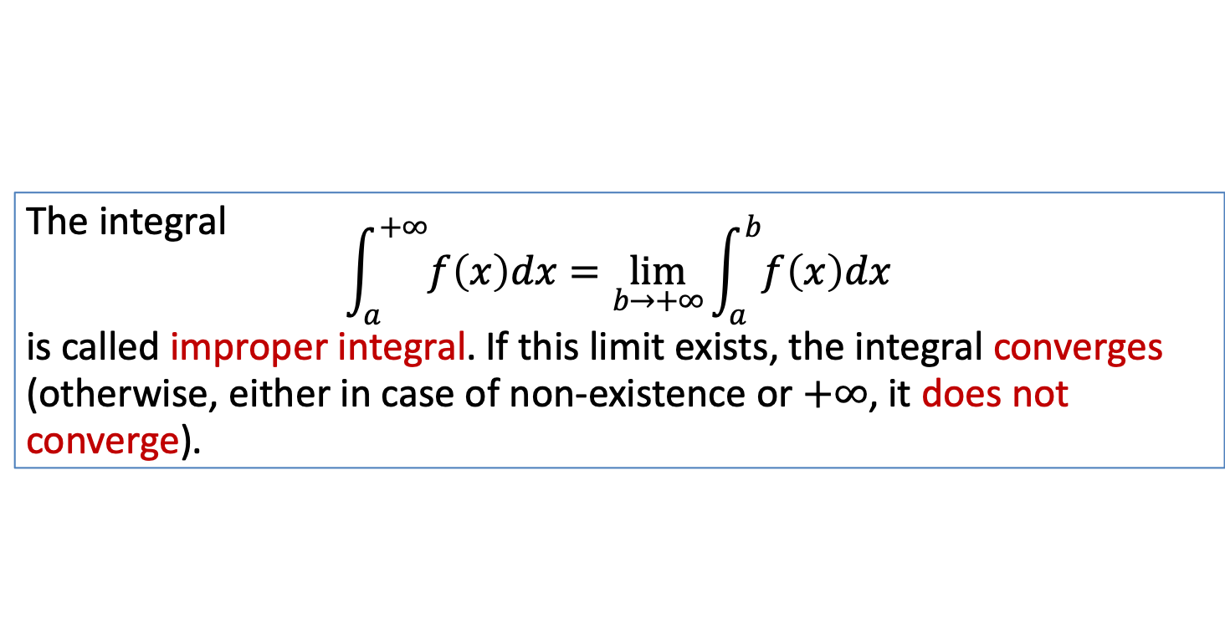
Definite integral: improper integrals
The integral
$$\int_{a}^{+∞}{f\left(x\right)dx}=\lim_{b→+∞}{\int_{a}^{b}{f\left(x\right)dx}}$$
is called improper integral. If this limit exists, the integral converges (otherwise, either in case of non-existence or $+∞$, it does not converge).

Slide 42
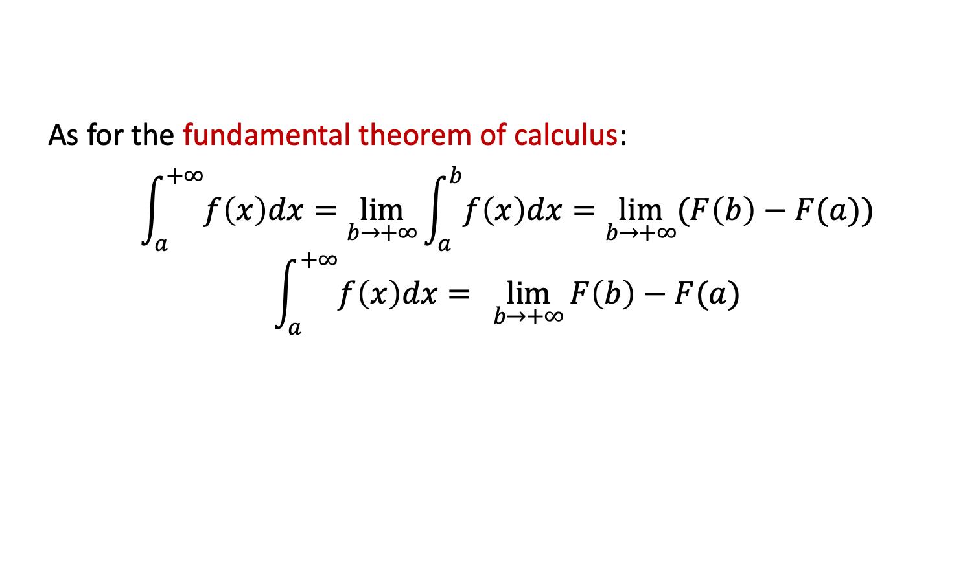
Definite integral: improper integrals
The integral
$$\int_{a}^{+∞}{f\left(x\right)dx}=\lim_{b→+∞}{\int_{a}^{b}{f\left(x\right)dx}}$$
is called improper integral. If this limit exists, the integral converges (otherwise, either in case of non-existence or $+∞$, it does not converge).
As for the fundamental theorem of calculus:
$$\int_{a}^{+∞}{f\left(x\right)dx}=\lim_{b→+∞}{\int_{a}^{b}{f\left(x\right)dx}=\lim_{b→+∞}{(F\left(b\right)−F(a))}}$$
$$\int_{a}^{+∞}{f\left(x\right)dx}={\lim_{b→+∞}{F\left(b\right)−F(a)}}$$

Slide 43
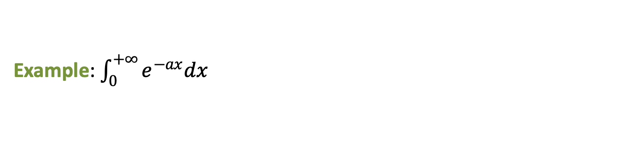
Definite integral: improper integrals
The integral
$$\int_{a}^{+∞}{f\left(x\right)dx}=\lim_{b→+∞}{\int_{a}^{b}{f\left(x\right)dx}}$$
is called improper integral. If this limit exists, the integral converges (otherwise, either in case of non-existence or $+∞$, it does not converge).
As for the fundamental theorem of calculus:
$$\int_{a}^{+∞}{f\left(x\right)dx}=\lim_{b→+∞}{\int_{a}^{b}{f\left(x\right)dx}=\lim_{b→+∞}{(F\left(b\right)−F(a))}}$$
$$\int_{a}^{+∞}{f\left(x\right)dx}={\lim_{b→+∞}{F\left(b\right)−F(a)}}$$
Example: $\int_{0}^{+∞}{e^{−ax}dx}$

Slide 44

Definite integral: improper integrals
Example: $\int_{1}^{+∞}{x^{−a}dx}$

Slide 45
Definite integral: improper integrals
Example: $\int_{1}^{+∞}{x^{−a}dx}$
As a result, it converges if $a>1$, and does not converge otherwise.

Slide 46
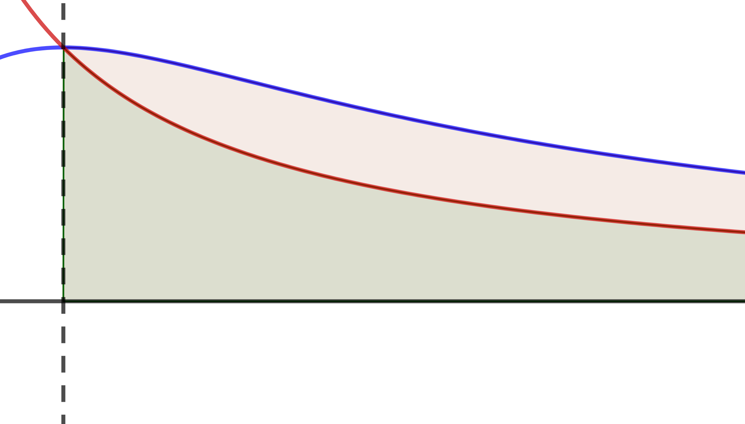
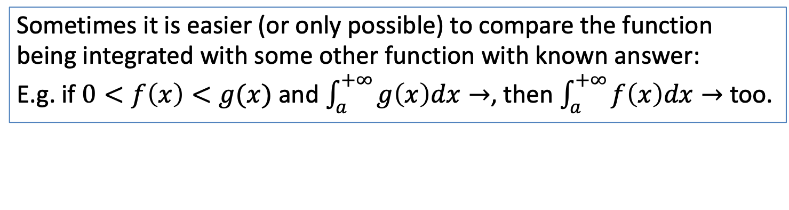
Definite integral: improper integrals
Example: $\int_{1}^{+∞}{x^{−a}dx}$
As a result, it converges if $a>1$, and does not converge otherwise.
Sometimes it is easier (or only possible) to compare the function being integrated with some other function with known answer:
E.g. if $0<f\left(x\right)<g(x)$ and $\int_{a}^{+∞}{g\left(x\right)dx}→$, then $\int_{a}^{+∞}{f\left(x\right)dx}→$ too.
g(x)
f(x)

Slide 47
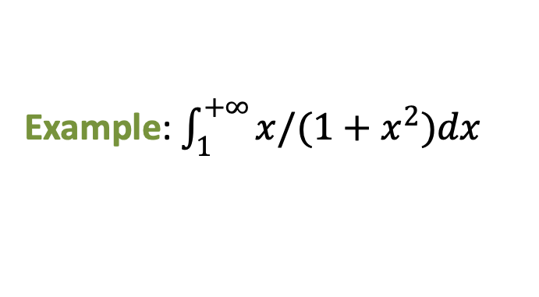
Definite integral: improper integrals
Example: $\int_{1}^{+∞}{x^{−a}dx}$
As a result, it converges if $a>1$, and does not converge otherwise.
Sometimes it is easier (or only possible) to compare the function being integrated with some other function with known answer:
E.g. if $0<f\left(x\right)<g(x)$ and $\int_{a}^{+∞}{g\left(x\right)dx}→$, then $\int_{a}^{+∞}{f\left(x\right)dx}→$ too.
Example: $\int_{1}^{+∞}{x/(1+x^{2})dx}$
g(x)
f(x)

Slide 48
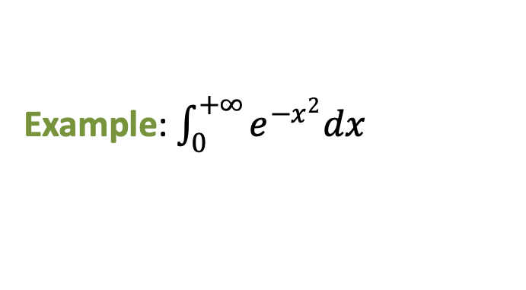
Definite integral: improper integrals
Example: $\int_{1}^{+∞}{x^{−a}dx}$
As a result, it converges if $a>1$, and does not converge otherwise.
Sometimes it is easier (or only possible) to compare the function being integrated with some other function with known answer:
E.g. if $0<f\left(x\right)<g(x)$ and $\int_{a}^{+∞}{g\left(x\right)dx}→$, then $\int_{a}^{+∞}{f\left(x\right)dx}→$ too.
Example: $\int_{0}^{+∞}{e^{−x^{2}}dx}$

Slide 49
Definite integral: numerical methods
Now we know analytical methods to compute an integral. But what if our function is also given only at certain points of the grid or cannot be integrated in elementary functions?

Slide 50
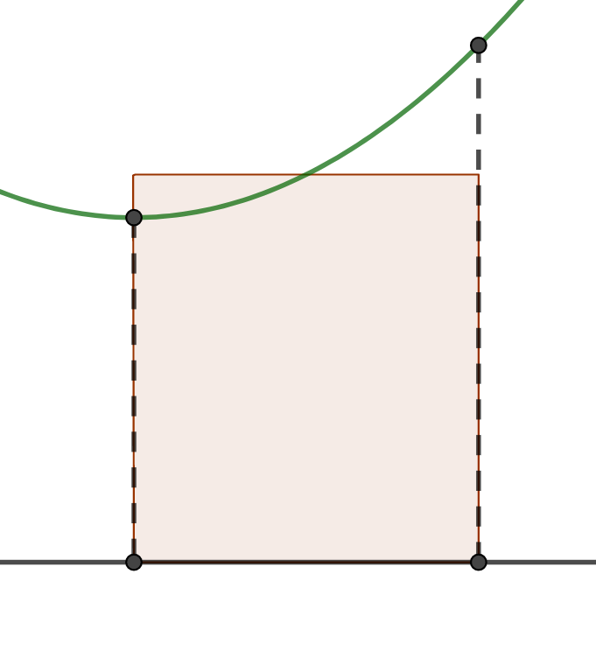
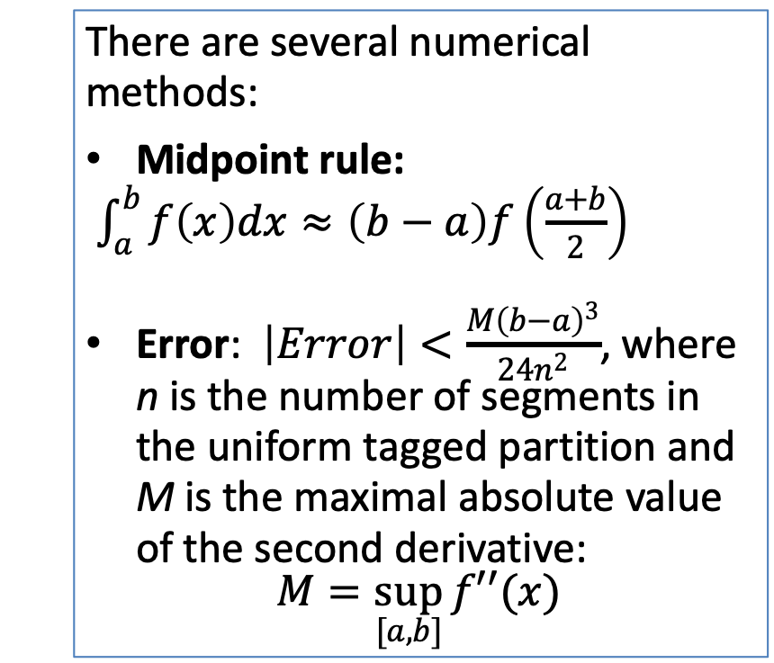
Definite integral: numerical methods
Now we know analytical methods to compute an integral. But what if our function is also given only at certain points of the grid or cannot be integrated in elementary functions?
There are several numerical methods:
Midpoint rule:
$\int_{a}^{b}{f\left(x\right)dx≈\left(b−a\right)f\left(\frac{a+b}{2}\right)}$
Error: $\left|Error\right|<\frac{M{\left(b−a\right)}^{3}}{24n^{2}}$, where n is the number of segments in the uniform tagged partition and M is the maximal absolute value of the second derivative:
$$M=\sup_{[a,b]}{f′′(x)}$$
f(x)
a
b

Slide 51
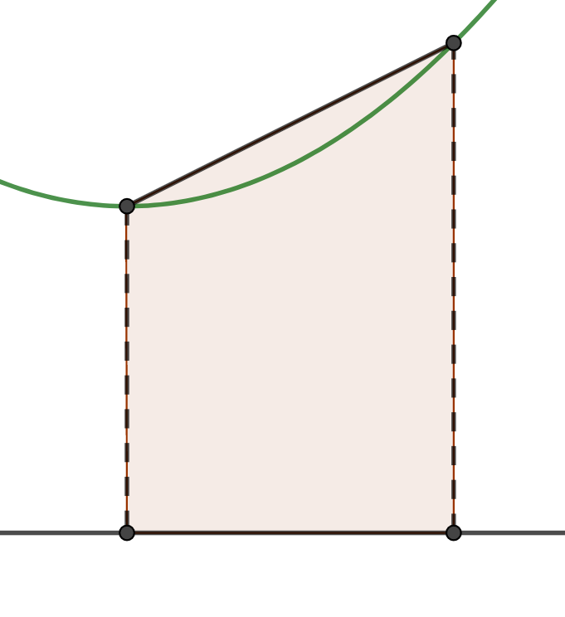

Definite integral: numerical methods
Now we know analytical methods to compute an integral. But what if our function is also given only at certain points of the grid or cannot be integrated in elementary functions?
There are several numerical methods:
Trapezoidal rule:
$\int_{a}^{b}{f\left(x\right)dx≈\left(b−a\right)\left(\frac{f(a)+f(b)}{2}\right)}$
Error: $\left|Error\right|<\frac{M{\left(b−a\right)}^{3}}{12n^{2}}$, where n is the number of segments in the uniform tagged partition and M is the maximal absolute value of the second derivative:
$$M=\sup_{[a,b]}{f′′(x)}$$
f(x)
a
b

Slide 52
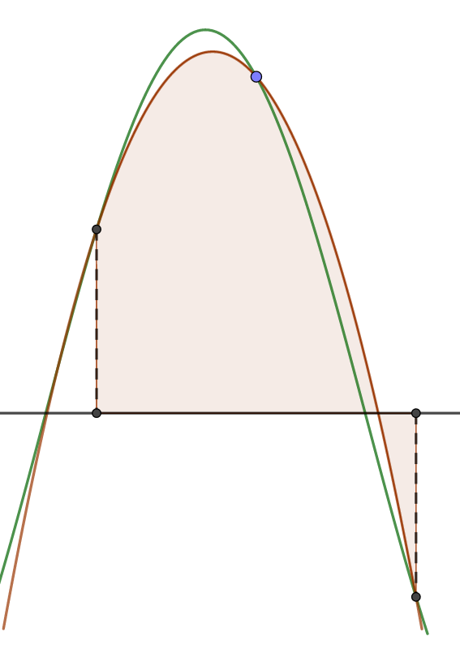
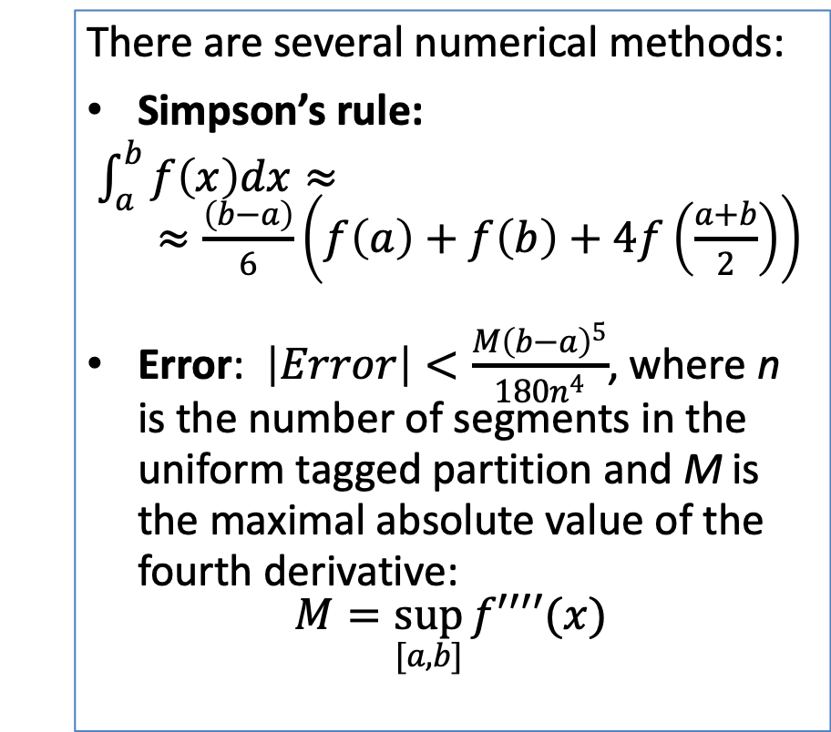
Definite integral: numerical methods
Now we know analytical methods to compute an integral. But what if our function is also given only at certain points of the grid or cannot be integrated in elementary functions?
There are several numerical methods:
Simpson’s rule:
$\int_{a}^{b}{f\left(x\right)dx≈}$
$≈\frac{\left(b−a\right)}{6}\left(f\left(a\right)+f\left(b\right)+4f\left(\frac{a+b}{2}\right)\right)$
Error: $\left|Error\right|<\frac{M{\left(b−a\right)}^{5}}{180n^{4}}$, where n is the number of segments in the uniform tagged partition and M is the maximal absolute value of the fourth derivative:
$$M=\sup_{[a,b]}{f′′′′(x)}$$
b
a

Slide 53
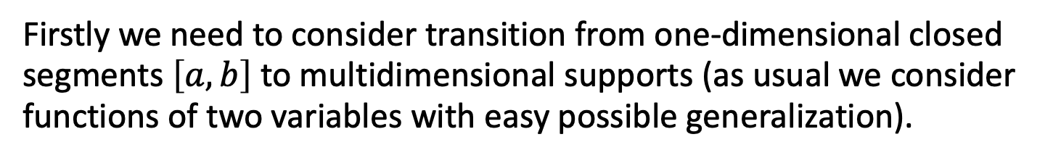
Multivariate functions
Firstly we need to consider transition from one-dimensional closed segments $\left[a, b\right]$ to multidimensional supports (as usual we consider functions of two variables with easy possible generalization).

Slide 54

Multivariate functions
Firstly we need to consider transition from one-dimensional closed segments $\left[a, b\right]$ to multidimensional supports (as usual we consider functions of two variables with easy possible generalization).
We will consider integration over open connected subsets of the real plane.
A subset A considered open if each point of A included into the subset with some its neighborhood.
A

Slide 55


Multivariate functions
Firstly we need to consider transition from one-dimensional closed segments $\left[a, b\right]$ to multidimensional supports (as usual we consider functions of two variables with easy possible generalization).
We will consider integration over open connected subsets of the real plane.
A subset A considered open if each point of A included into the subset with some its neighborhood.
Consider the same technique of partition (into the same open connected subsets) into ${{\left\{Δx_{i}\right\}}^{ }}_{i=1..m}$.
The diameter is defined in the same way: for each subset defined most distant pair of points, and the maximal of those is chosen.
A

Slide 56


Multivariate functions
Firstly we need to consider transition from one-dimensional closed segments $\left[a, b\right]$ to multidimensional supports (as usual we consider functions of two variables with easy possible generalization).
We will consider integration over open connected subsets of the real plane.
A subset A considered open if each point of A included into the subset with some its neighborhood.
After tagging we get:
$S\left(τ,f,t\right)=\sum_{i=1}^{m}{f(u_{i},}v_{i})S_{Δx_{i}}$
As a result:
$$\lim_{d→0}{S\left(τ, f, t\right)=\iint{f\left(x,y\right)dxdy} }$$
A
A

Slide 57
Multivariate functions: Fubini’s theorem
The idea here is to integrate consequently by each variable.

Slide 58



Multivariate functions: Fubini’s theorem
The idea here is to integrate consequently by each variable.
Assume that we have two variable function $f(x,y)$ over rectangular subset
$$Π=\left[a,b\right]×[c,d]$$
d
$$Π$$
c
a
b

Slide 59


Multivariate functions: Fubini’s theorem
The idea here is to integrate consequently by each variable.
Assume that we have two variable function $f(x,y)$ over rectangular subset
$$Π=\left[a,b\right]×[c,d]$$
d
$$Π$$
c
The Fubini’s theorem claims the following:
$\iint{f\left(x,y\right)dxdy=\int_{a}^{b}{\left(\int_{c}^{d}{f(x,y)}dy\right)dx}}$
a
b
$$Π$$

Slide 60
Multivariate functions: Fubini’s theorem
The idea here is to integrate consequently by each variable.
Assume that we have two variable function $f(x,y)$ over rectangular subset
$$Π=\left[a,b\right]×[c,d]$$
d
$$Π$$
c
The Fubini’s theorem claims the following:
$\iint{f\left(x,y\right)dxdy=\int_{a}^{b}{\left(\int_{c}^{d}{f(x,y)}dy\right)dx}}$
a
b
$$Π$$
Example: $f\left(x,y\right)=xy^{2}$, $Π=\left[1, 3\right]×[2, 5]$

Slide 61




Multivariate functions: Fubini’s theorem
The idea here is to integrate consequently by each variable.
Assume that we have two variable function $f(x,y)$ over non-rectangular subset formed by lower and upper bounds $u\left(x\right)$ and $l(x)$
u(x)
A
The Fubini’s theorem claims the following:
$\iint{f\left(x,y\right)dxdy=\int_{a}^{b}{\left(\int_{l(x)}^{u(x)}{f(x,y)}dy\right)dx}}$
l(x)
a
b
$$A$$

Slide 62
Multivariate functions: Fubini’s theorem
The idea here is to integrate consequently by each variable.
Assume that we have two variable function $f(x,y)$ over non-rectangular subset formed by lower and upper bounds $u\left(x\right)$ and $l(x)$
u(x)
A
The Fubini’s theorem claims the following:
$\iint{f\left(x,y\right)dxdy=\int_{a}^{b}{\left(\int_{l(x)}^{u(x)}{f(x,y)}dy\right)dx}}$
l(x)
a
b
$$A$$

Slide 63
Multivariate functions: Fubini’s theorem
The idea here is to integrate consequently by each variable.
Assume that we have two variable function $f(x,y)$ over non-rectangular subset formed by lower and upper bounds $u\left(x\right)$ and $l(x)$
u(x)
A
The Fubini’s theorem claims the following:
$\iint{f\left(x,y\right)dxdy=\int_{a}^{b}{\left(\int_{l(x)}^{u(x)}{f(x,y)}dy\right)dx}}$
l(x)
a
b
$$A$$
Example: $f\left(x,y\right)=xy^{2}$, $A=\left\{x∈\left[0,1\right], y=0, y=2x\right\}$

Slide 64
Week 5 Integrals: anti-derivative, area under curve, multivariate functions

